Slide 1
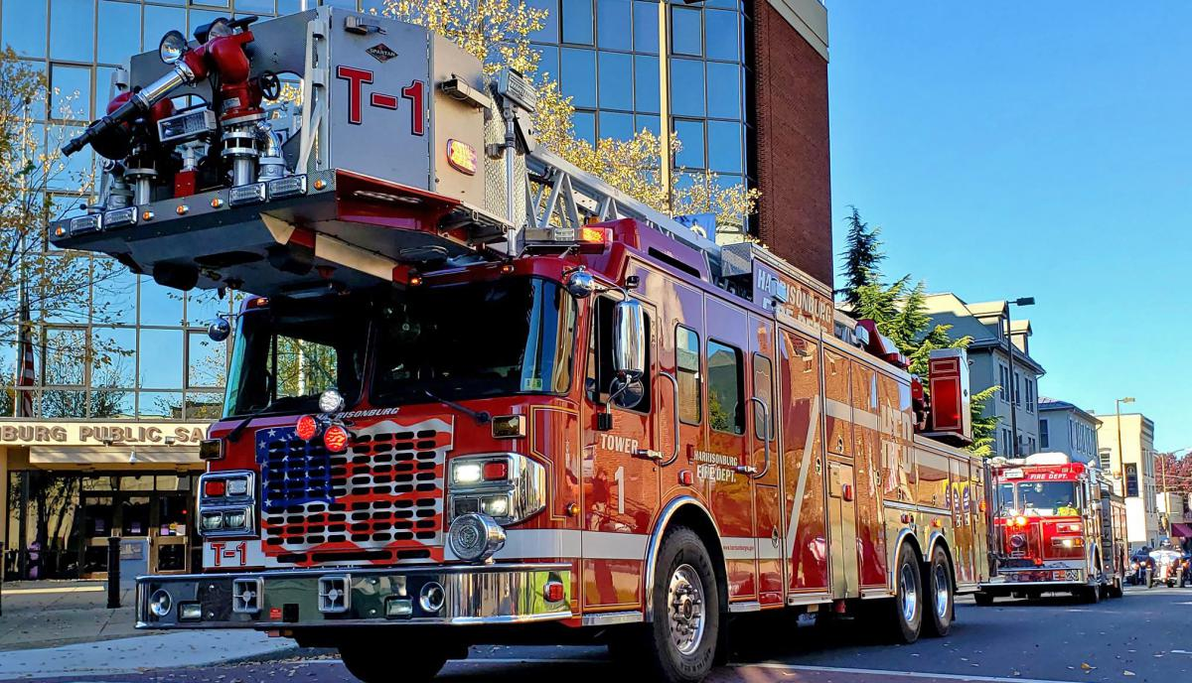


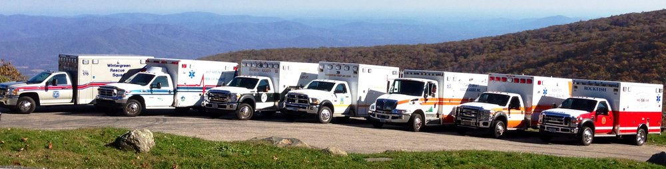
Emergency Vehicle
Operator’s Course
Updated 7/1/2022
Notes:
New Logo – Eliminated date in slide title – added dated updated 7/1/22

Slide 2

INSTRUCTOR
INTRODUCTIONS
1-1
Notes:
Introduce all instructors present and identify whether VAVRS or VDFP instructors

Slide 3
Course provided by the
Virginia Department of Fire Programs
and the
Virginia Association of Volunteer Rescue Squads, Inc.
1-2
Notes:
State that VDFP and VAVRS cooperate with the program design and update at least every five years

Slide 4
Virginia Department of Fire Programs:
Who We Are
Vision
The Virginia Department of Fire Programs (VDFP) will be a nationally recognized leader in providing the highest level of fire services professional development and statewide risk reduction efforts.
Mission
The Virginia Department of Fire Programs (VDFP) is committed to enhancing public safety throughout the Commonwealth.
1-3
Notes:
VDFP Vision and MIssion

Slide 5
The Virginia Association of Volunteer Rescue Squads (VAVRS)
  501C3 Non-profit Organization
  Organized in 1935 in Roanoke, Virginia
  330+ volunteer EMS agencies, rescue squads, fire departments, first responder and specialty rescue related agencies
  20,000+ members
  The Virginia Association of Volunteer Rescue Squads is THE voice of EMS…. the advocate for our members, Virginia’s EMS agencies and providers.
  We link members and agencies for the purpose of sharing ideas, giving you a voice at the General Assembly, on state advisory boards, as well as on state and local committees.
  VAVRS State Office and Training Center
  P O Box 279 – 2535 Turkey Creek Road
  Oilville, VA 23129 (800) – 833-0602
  www.vavrs.com / vavrs@vavrs.com
1-4
Notes:
VAVRS Vision and Goals

Slide 6
Session 1
1-5
Notes:
Session 1

Slide 7
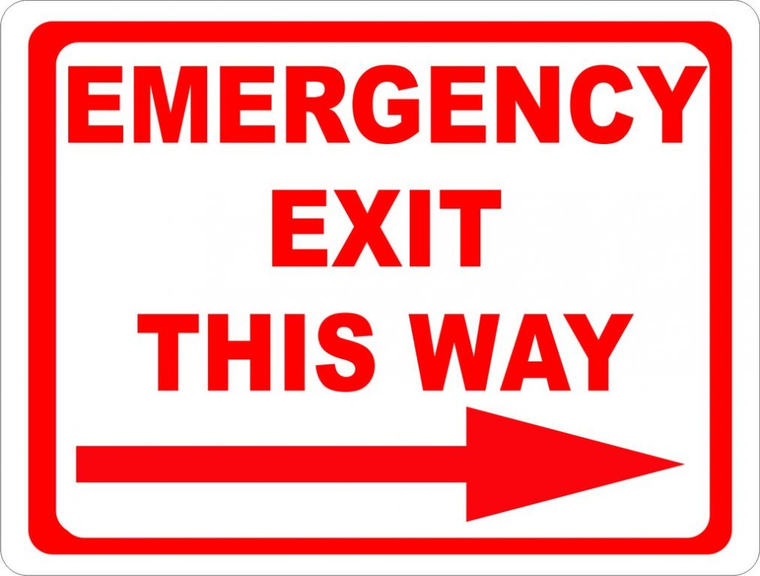
Housekeeping
Bathrooms
Emergency Exits
Smoking Areas
Snack Locations
Trip Hazards
1-6
Notes:
Cover any classroom rules or special circumstances

Slide 8
Course Pre-Requisites
  Minimum 18 years of age the first day of course
  Have any valid driver’s license
  Be affiliated or have pending affiliation with an Emergency Services Organization
1-7
Notes:
If anyone in class is less than 18 years of age they cannot participate in the class. Check driver’s licenses and ask each participant their agency affiliation.

Slide 9
Certification Requirements
  Must attend 100% of the course
  Must successfully complete written examination with a score of 70% or above
  Must successfully complete practical skills evaluation (cone judgement course)
1-8
Notes:
All students must return promptly after breaks and if they leave to run a call they will not meet the minimum requirements for class attendance

Slide 10
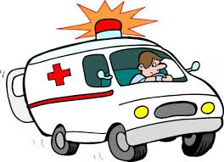
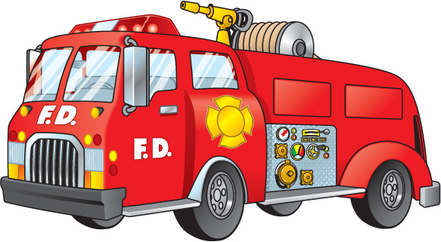
Driving Experience
It is highly recommended that a student have prior driving experience in the vehicle type and classification in which they are attempting to gain certification.
1-9
Notes:
Encourage participants to get some driving practice with the type of vehicle(s) they intend to seek certification.

Slide 11
Class Objectives
  To acquaint the student with the theories and practices of emergency vehicle operations.
  Allow the student to demonstrate their skills in vehicle operations through the use of predetermined practical evolutions.
1-10
Notes:
Alert students that some of the content may be a review of what they already know but this review is the basis for improving their success in driving emergency vehicles during highly stressful situations.

Slide 12
Class Objectives
It is designed to explain how emergency driving differs from non-emergency driving and to test the driving skills of the student. Completion also satisfies the minimum requirements for an operator of an emergency vehicle as defined by the Virginia Office of EMS.
This course DOES NOT teach the student to drive and completing this course DOES NOT designate you as a driver in your agency.
1-11
Notes:
Emphasize the course DOES NOT authorize them to drive agency vehicles – the operational leadership and/or agency protocols/procedures cover those requirements. The Virginia Office of EMS recognition of an EVOC certification from a VAOEMS recognized course is an absolute requirement to operate an emergency vehicle on an emergency call. This recognition does not expire even if the EVOC certification has an expiration date. There are no regulations that require EVOC for the fire service however many agencies have that requirement. EVOC is a requirement by VDFP to obtain certain levels of additional certification.

Slide 13
Vehicle Class Designations
Class 1
  0 – 10,000 pounds. Cars and small vehicles.
Class 2
  10,001 – 26,000 pounds. Most ambulances
and smaller fire apparatus.
Class 3
  26,001 + pounds. Most large fire apparatus and
heavy rescue vehicles.
1-12
Notes:
Announce to the students which class they will be completing during your course and how to obtain a higher level if they have the desire after completion of your course. VDFP has different practical evolution requirements and should be explained if this is a VDFP course.

Slide 14
Vehicle Class Designations
Class 4
  Tractor Drawn Apparatus - Aerial, Tanker / Tender, and Specialized Apparatus.
Class 5
  Aircraft Rescue and Fire Fighting Apparatus (Vehicle Class only used by agencies operating this type of vehicle).
1-13
Notes:
This courses are available but have special circumstances such as a much larger cone course and the availability of specific type of vehicles.

Slide 15
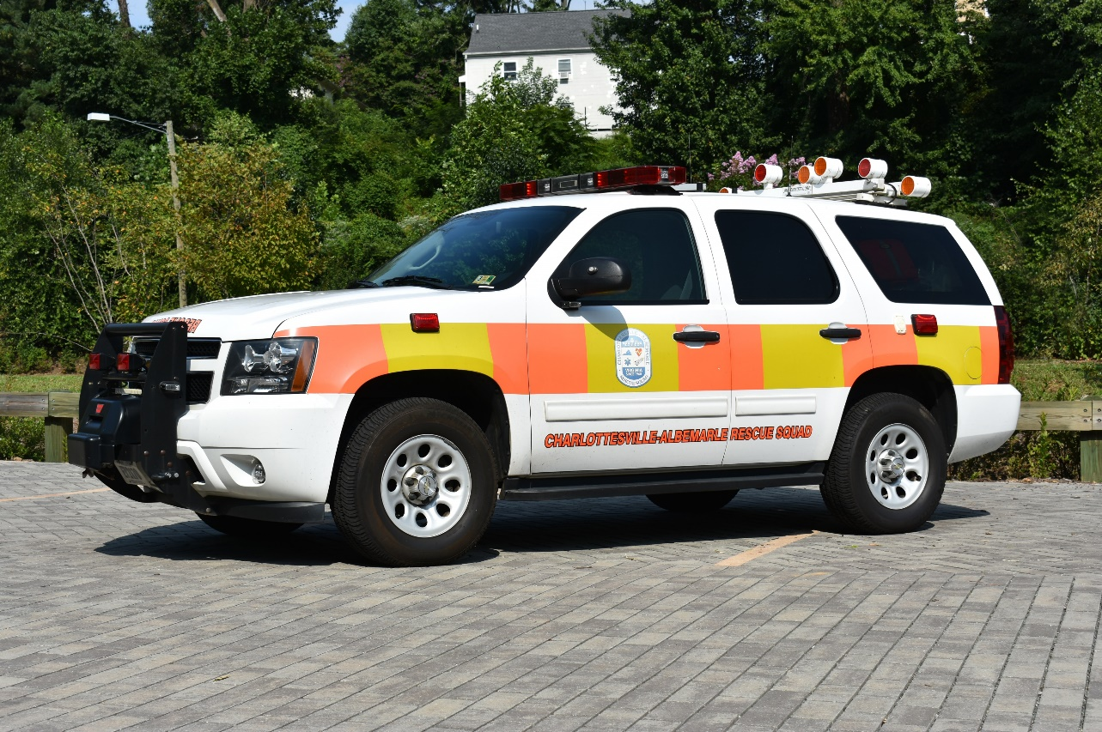
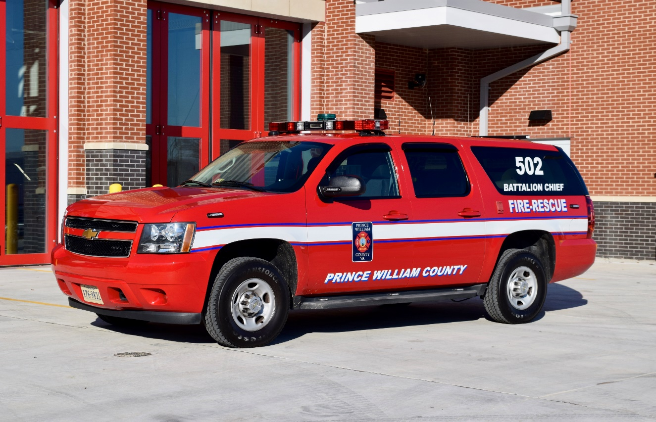
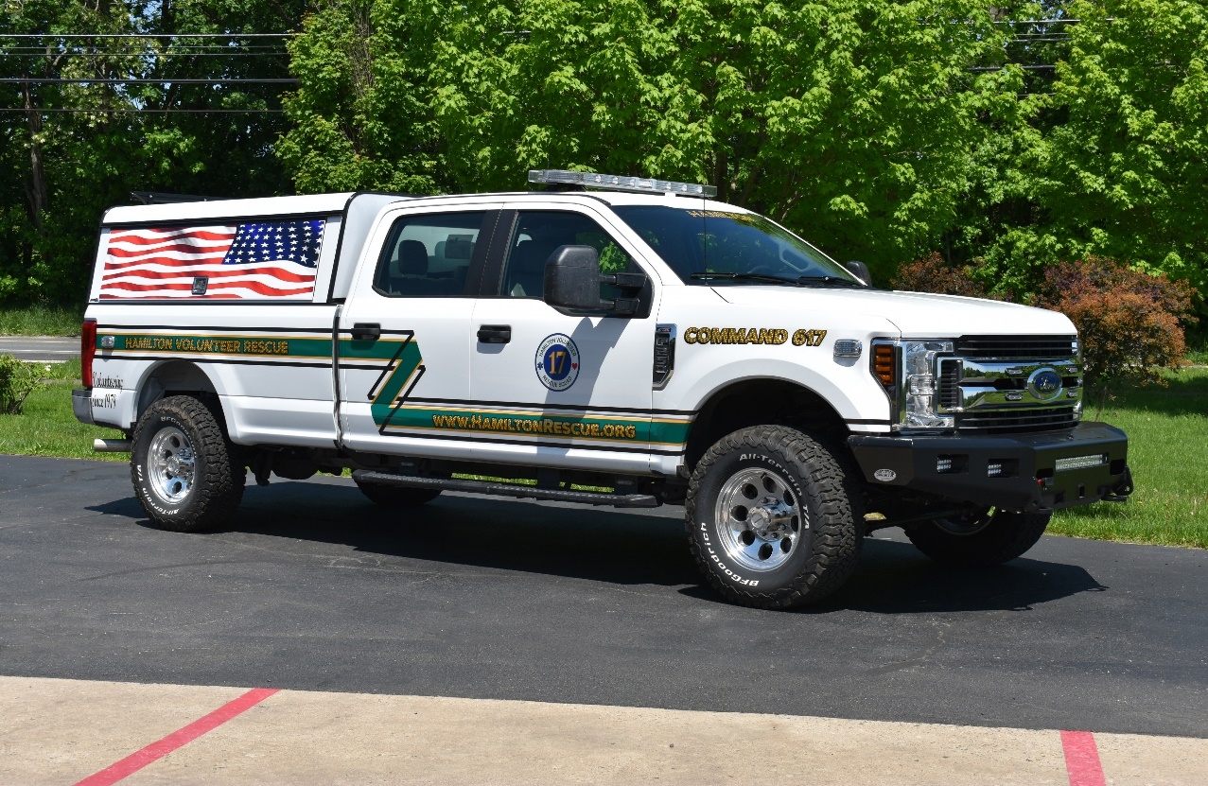
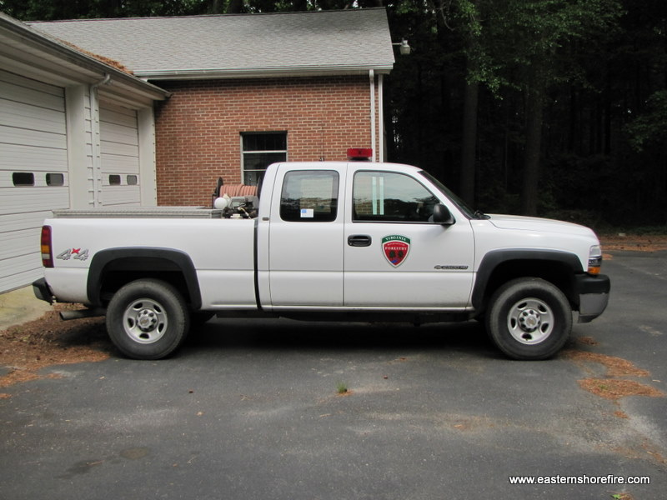
Class 1 Vehicles
1-14
Notes:
Updated Photos

Slide 16
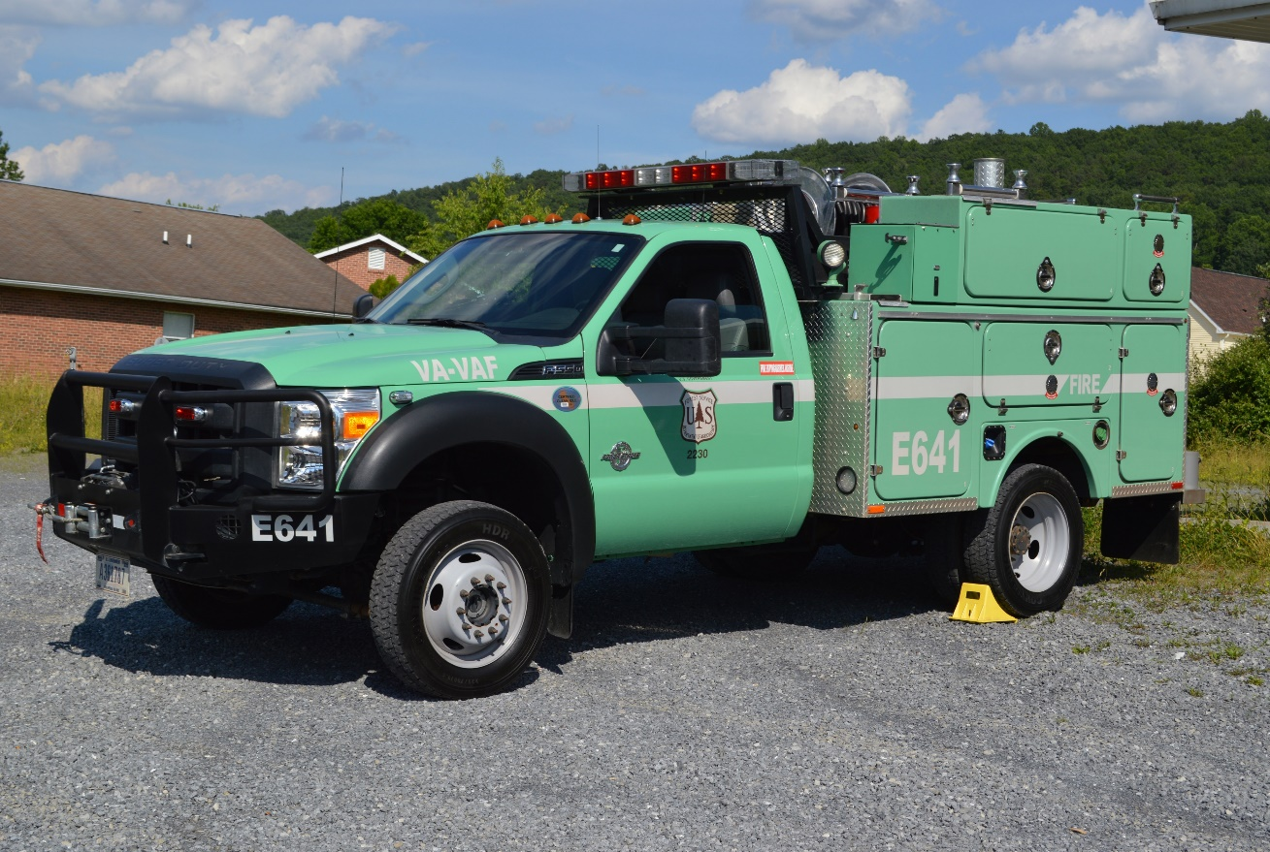
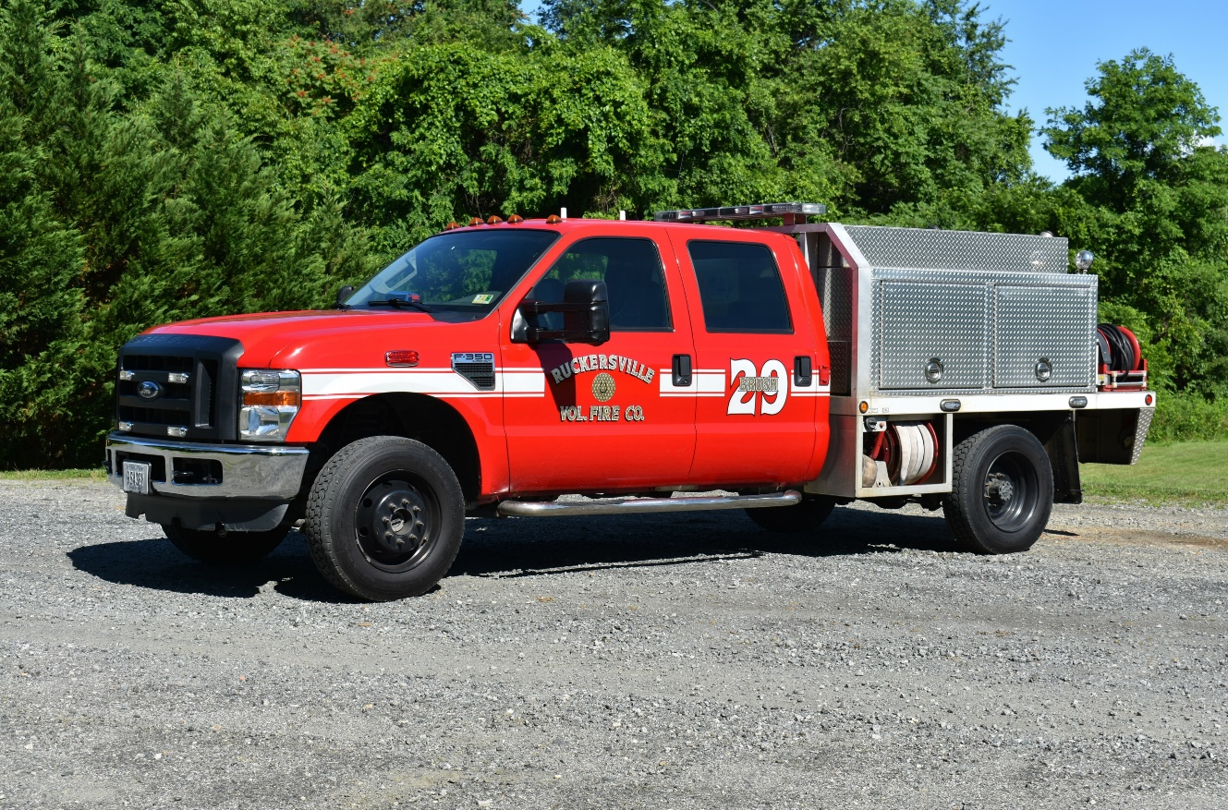
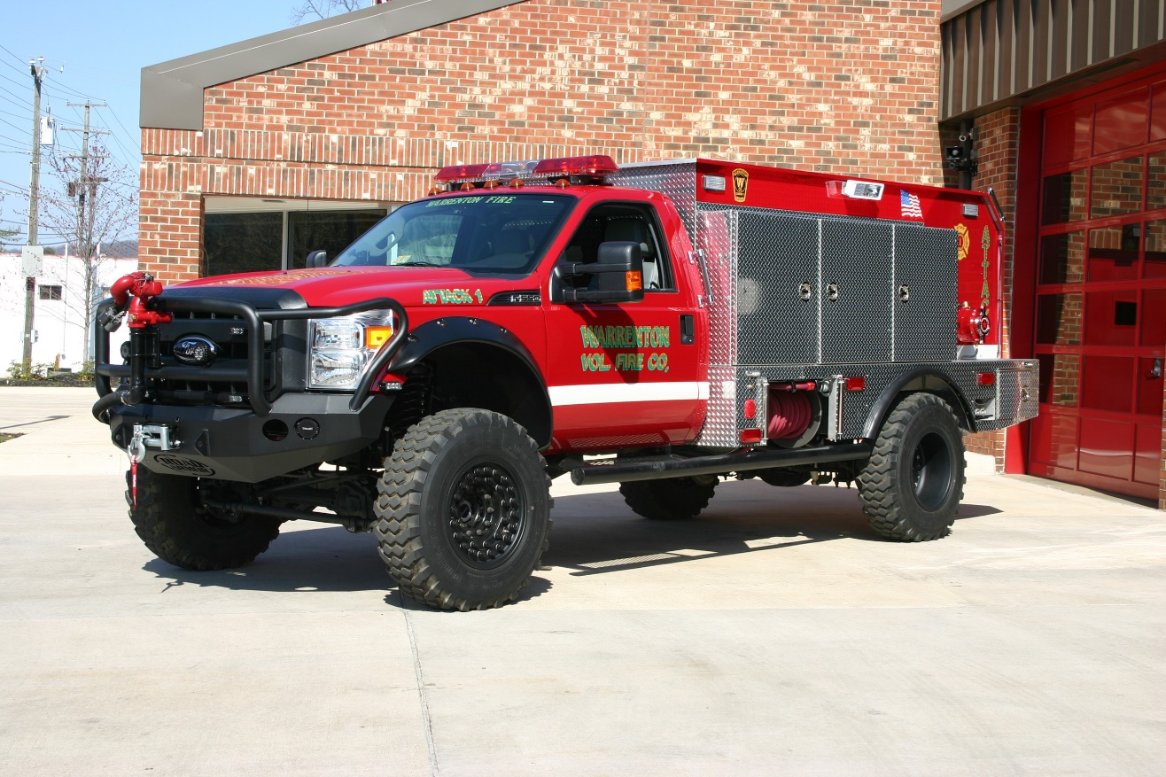
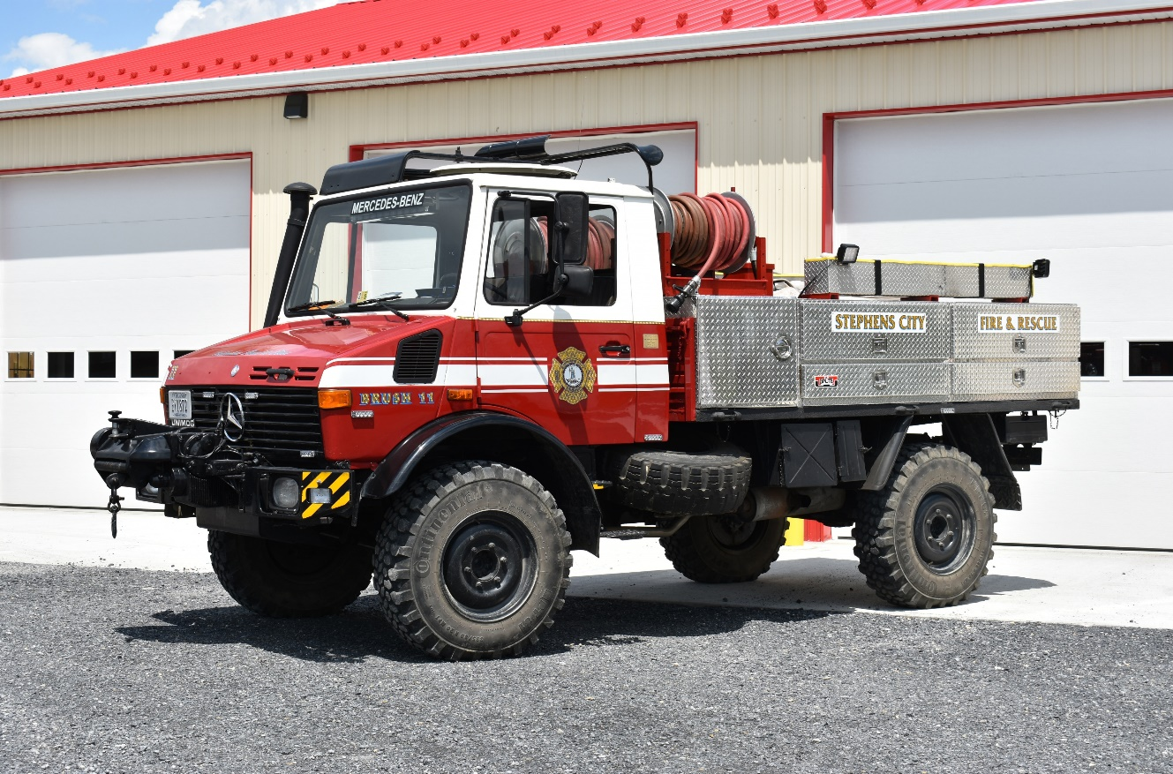
Class 2 Vehicles
1-15
Notes:
Updated Photos

Slide 17
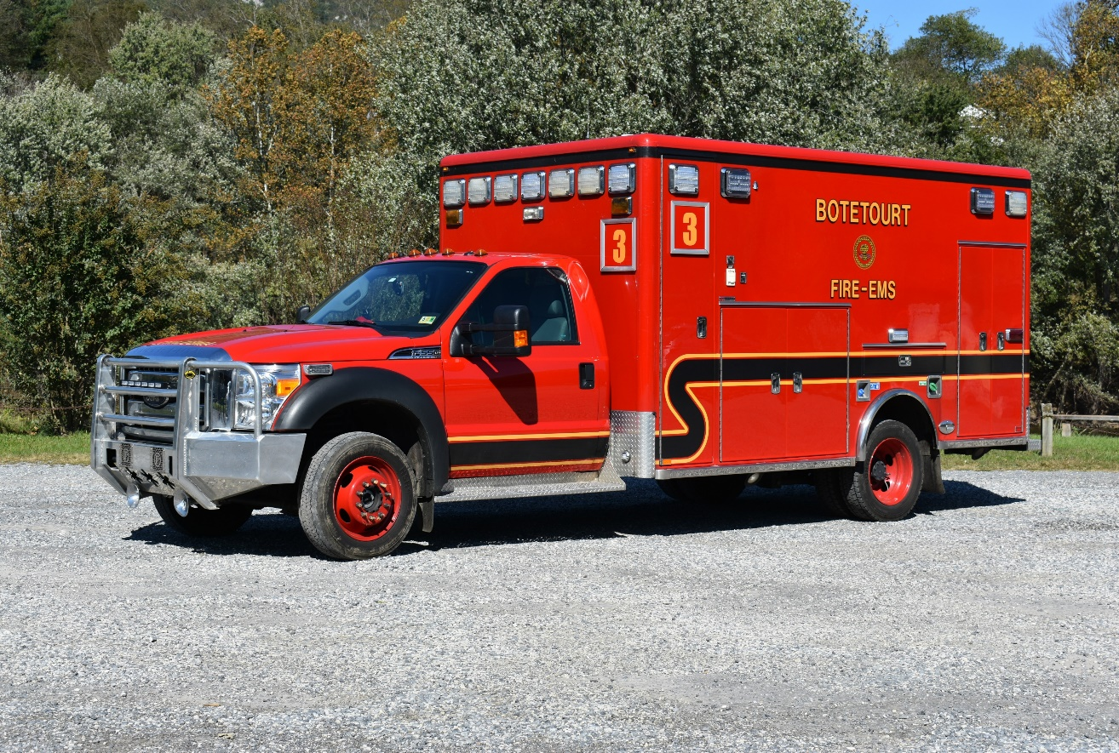
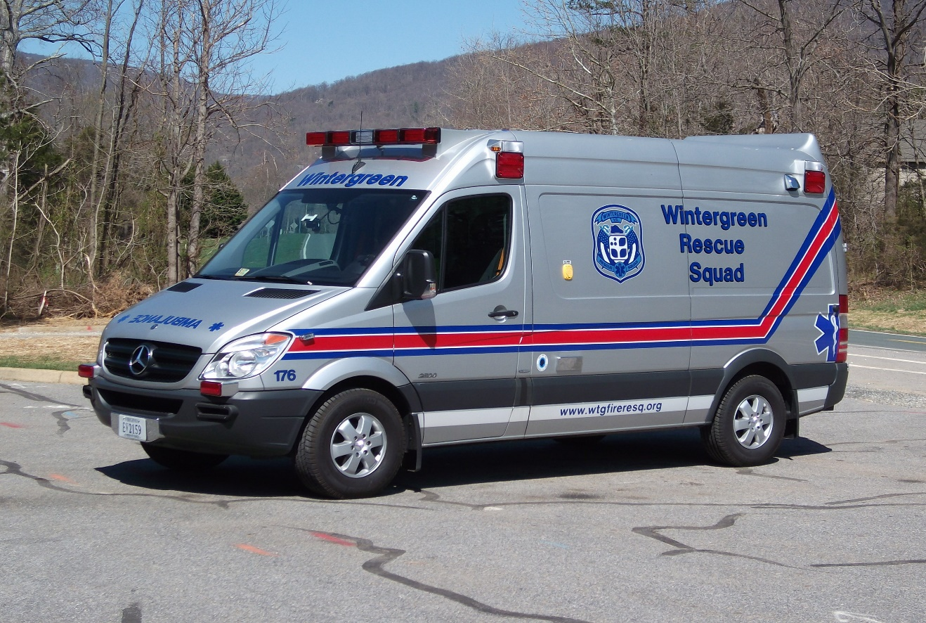
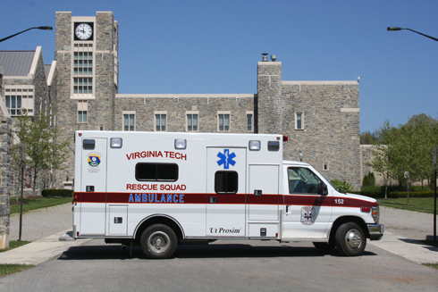
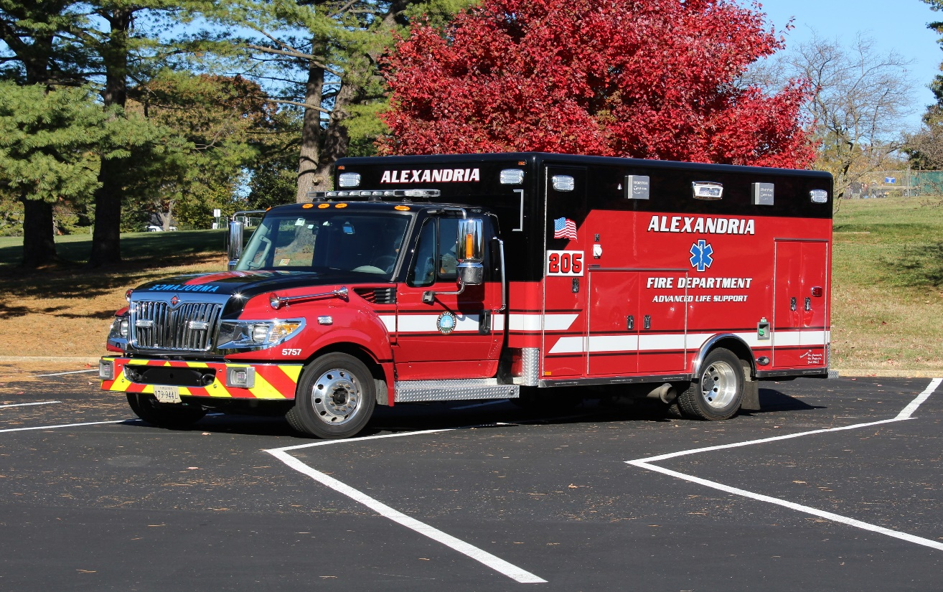
Class 2 Vehicles
1-16
Notes:
Updated Photos

Slide 18
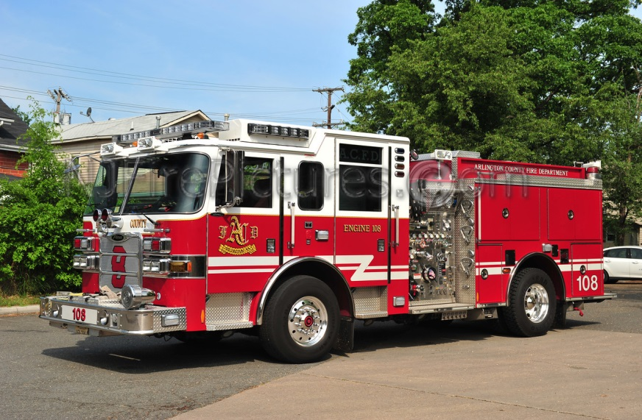
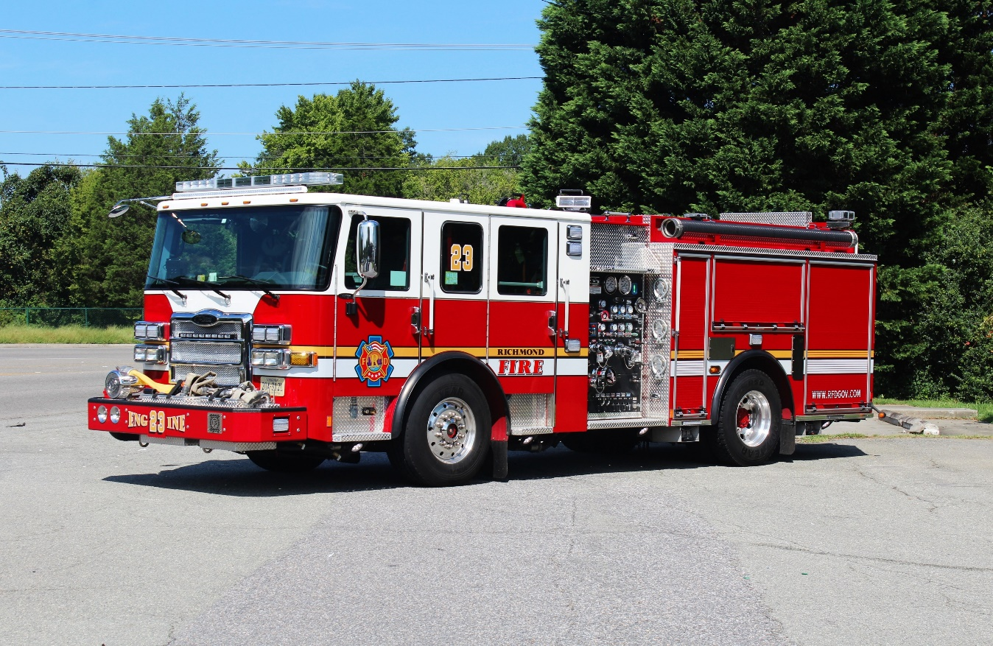
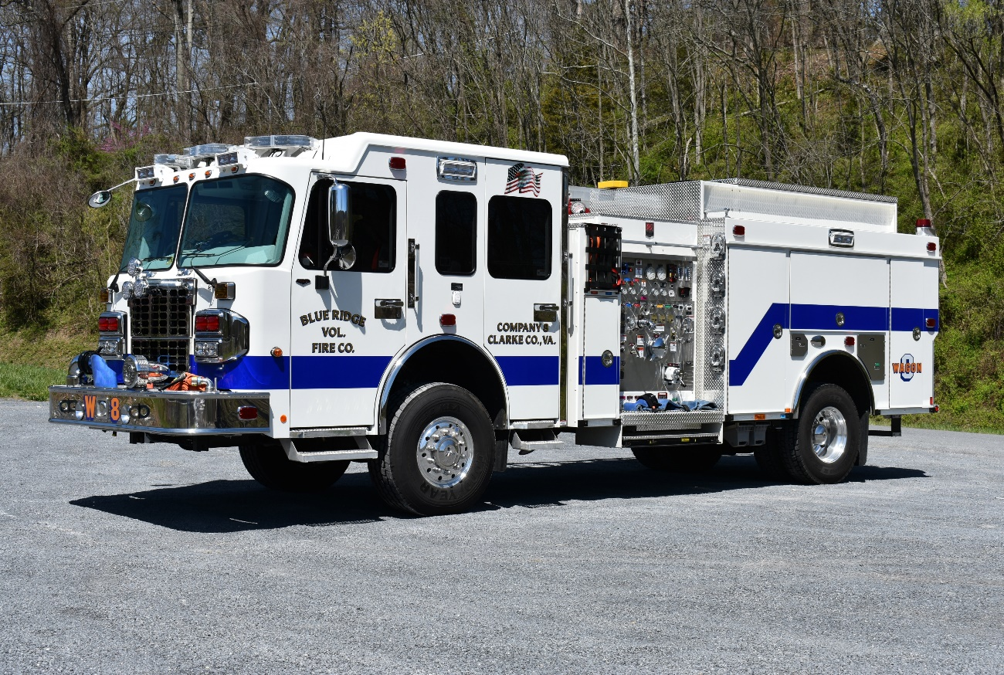
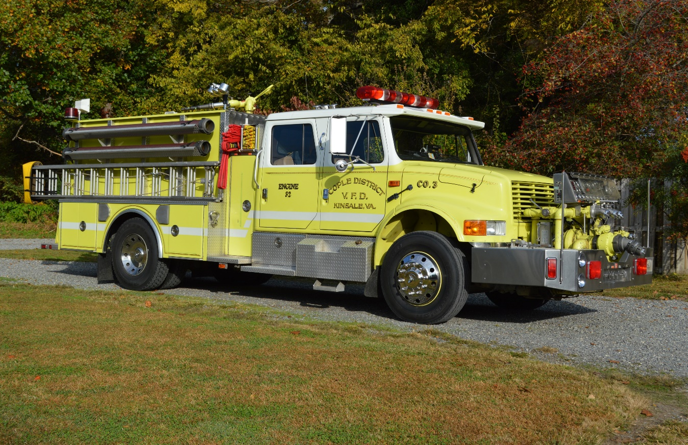
Class 3 Vehicles
1-17
Notes:
Updated Photos

Slide 19
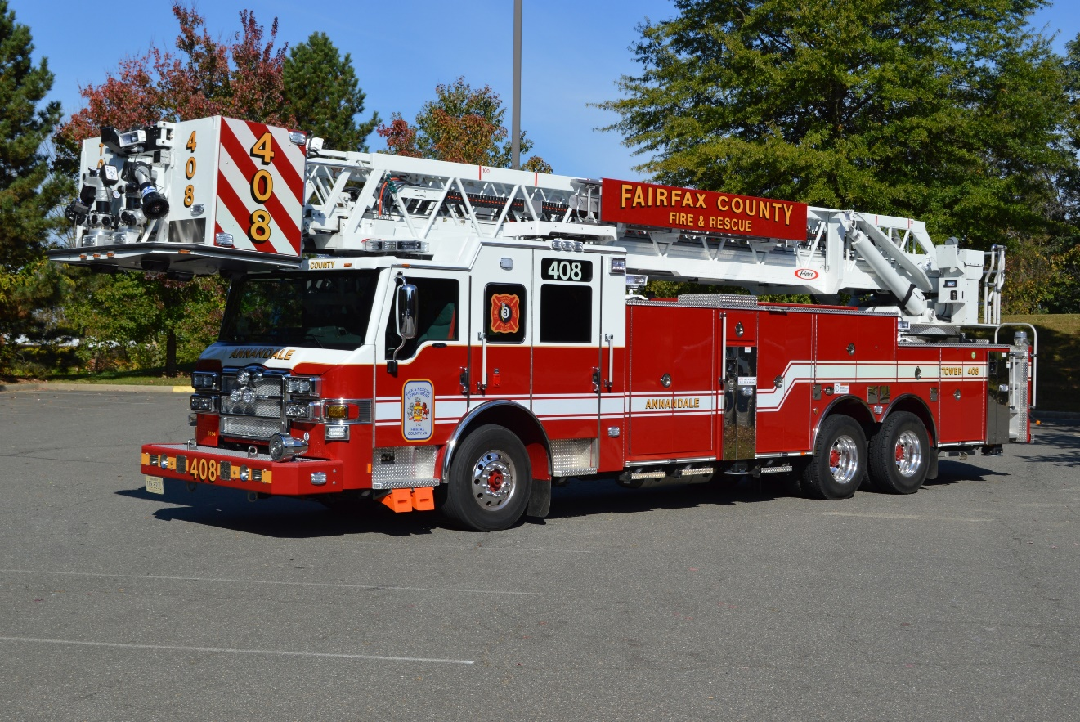
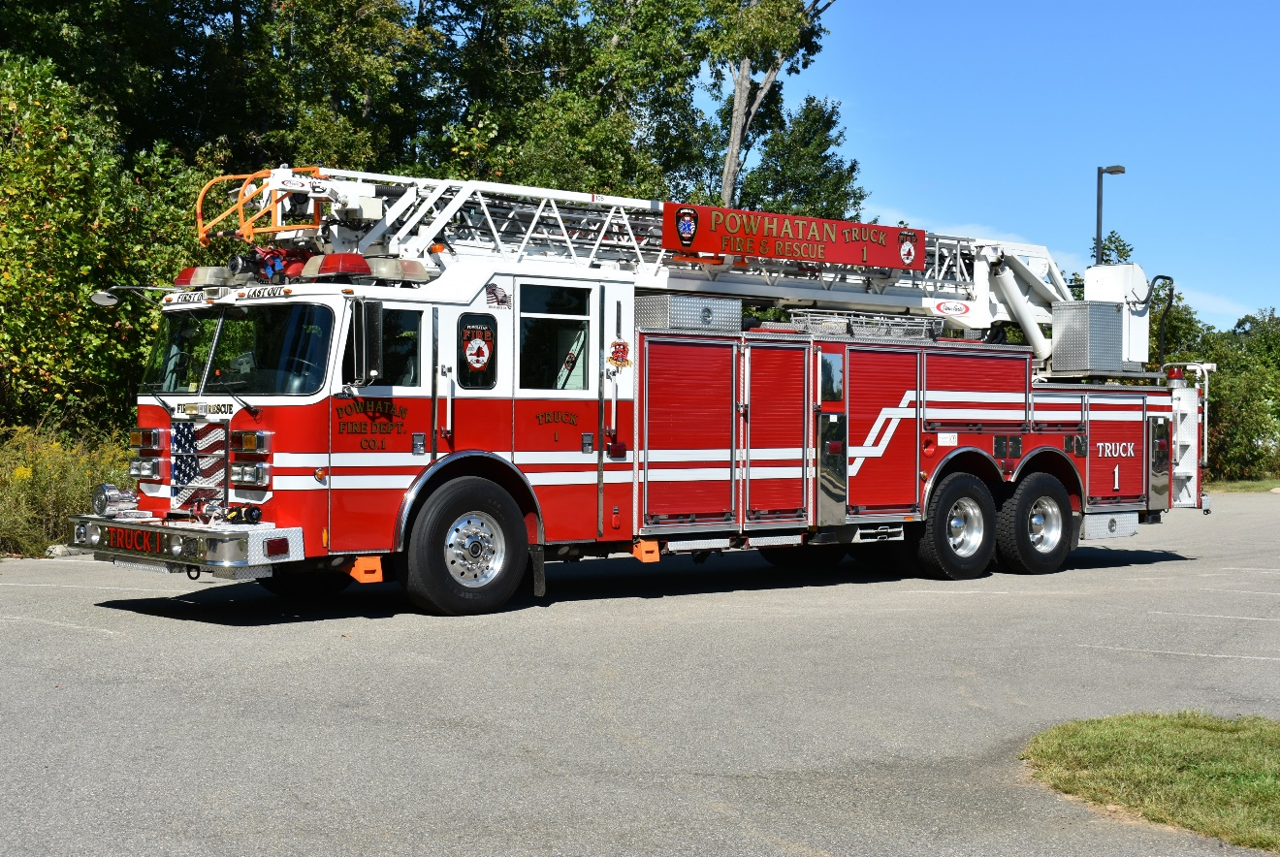
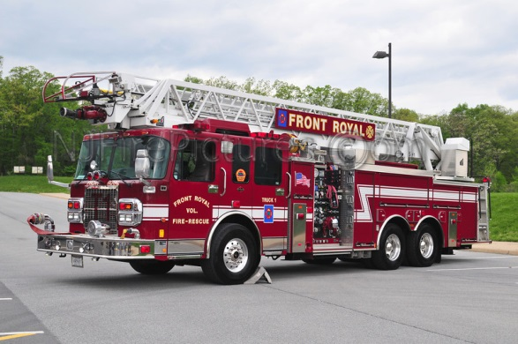
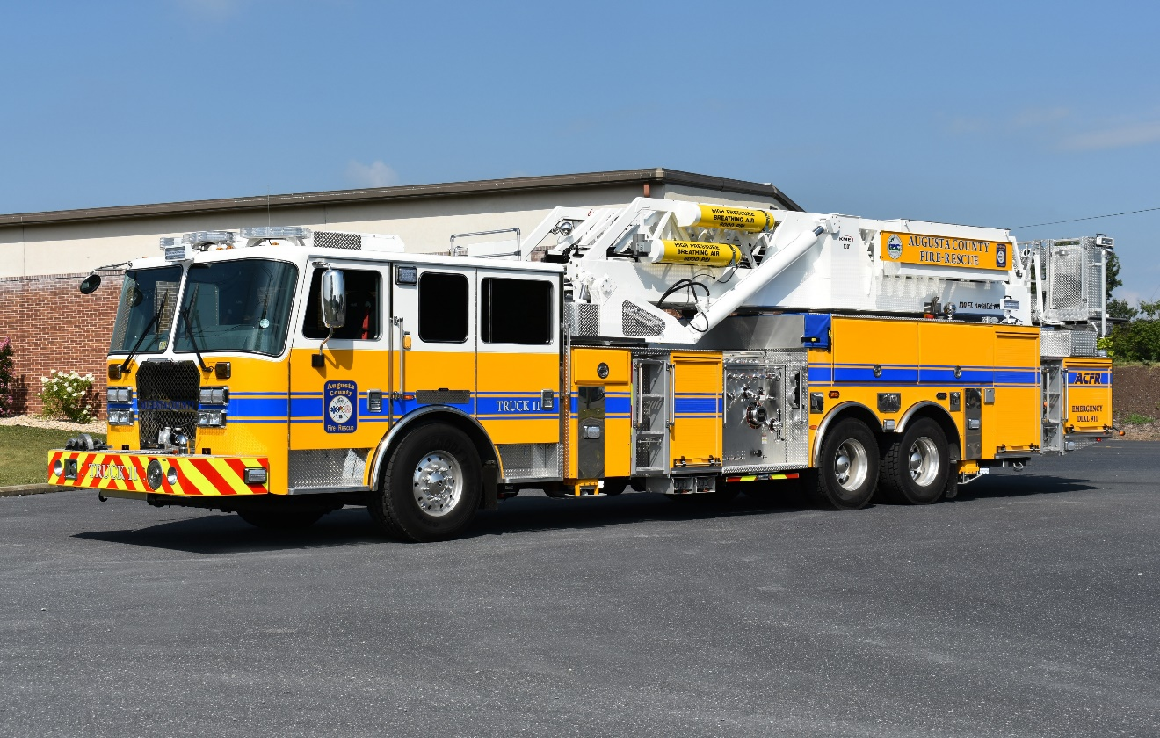
Class 3 Vehicles
1-18
Notes:
Updated Photos

Slide 20
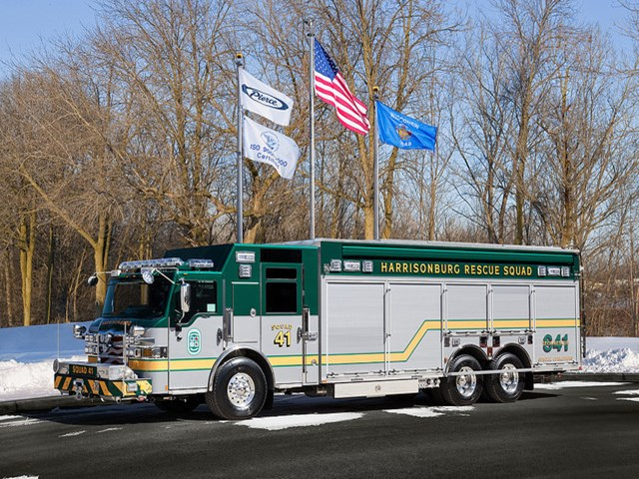
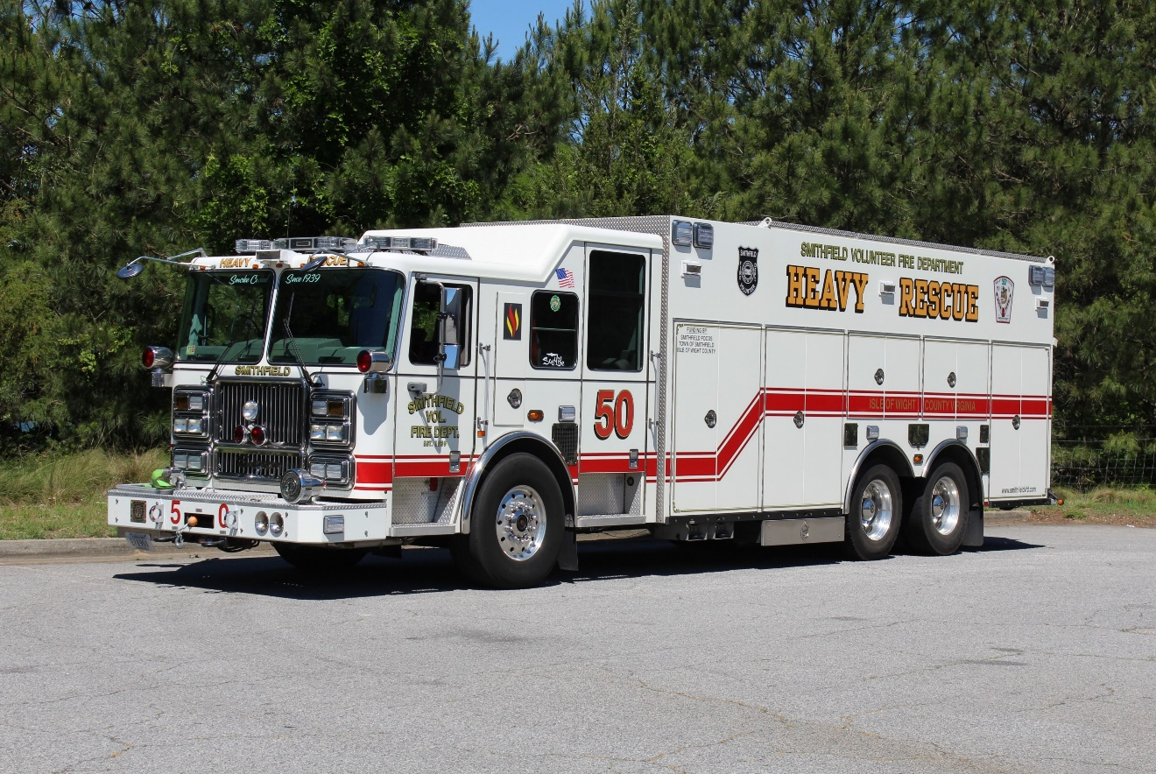
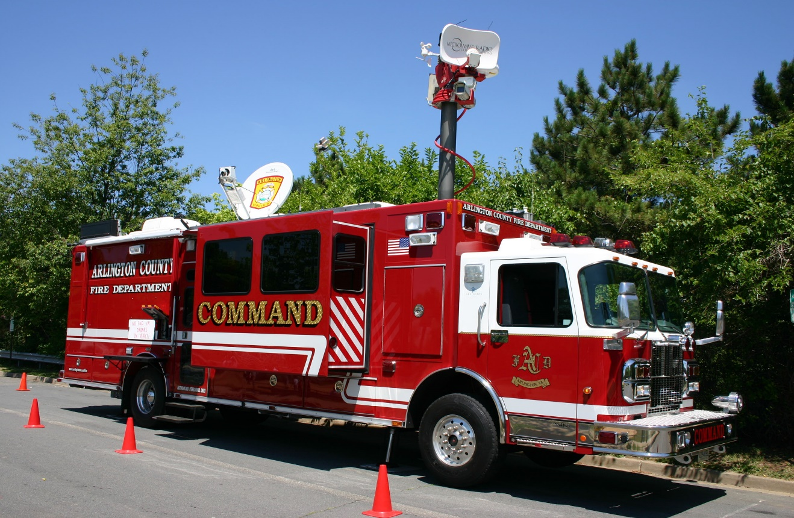
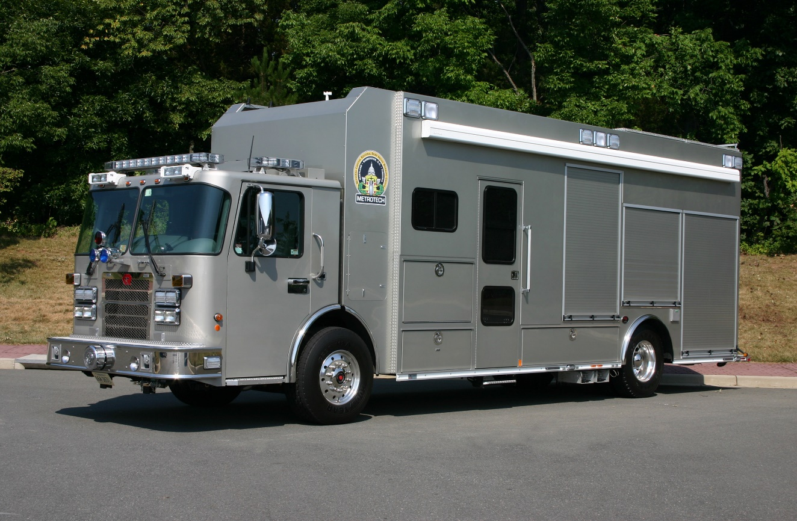
Class 3 Vehicles
1-19
Notes:
Updated Photos

Slide 21
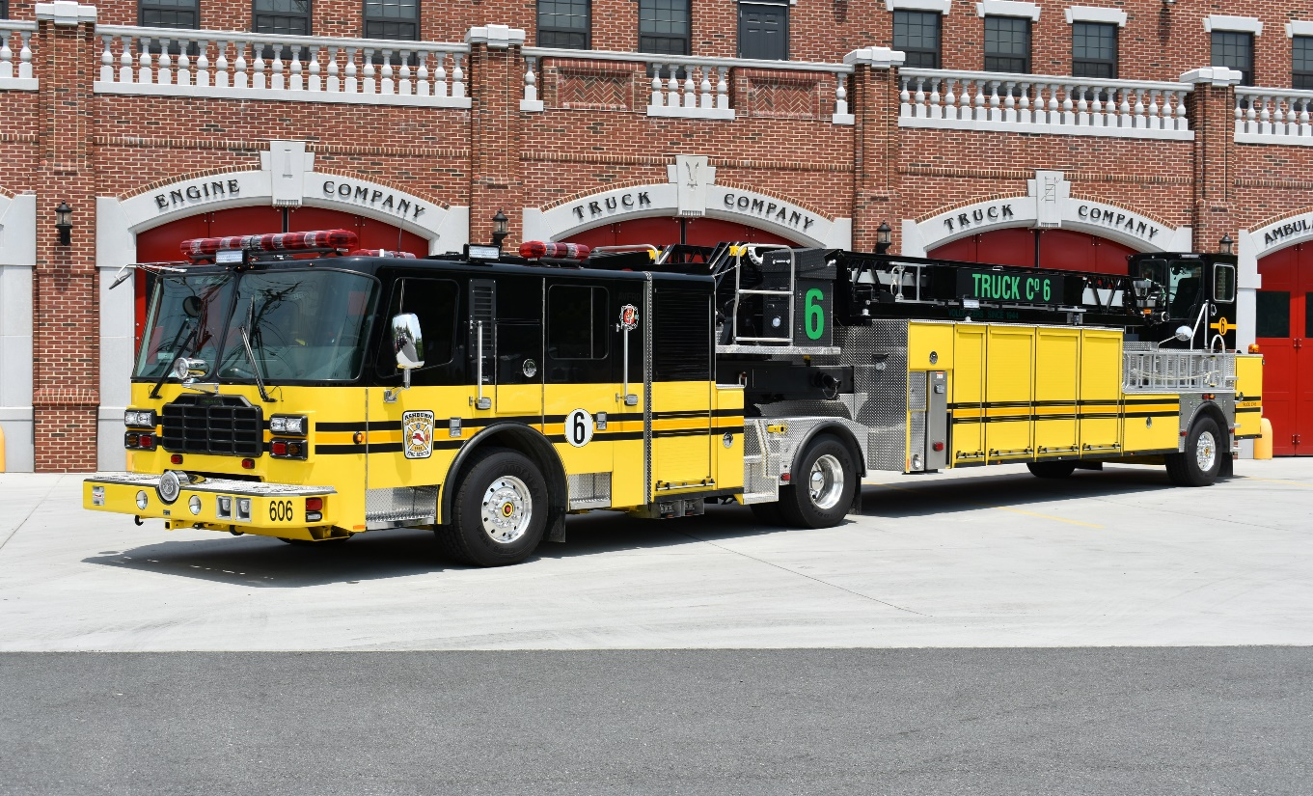
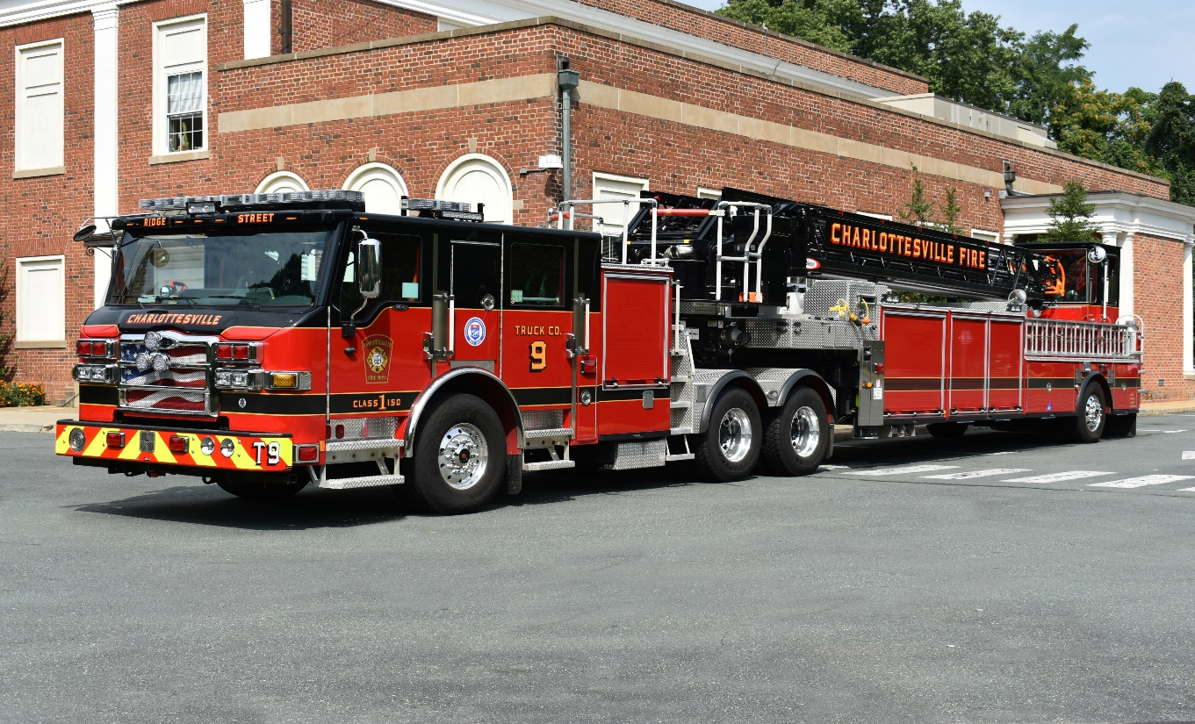
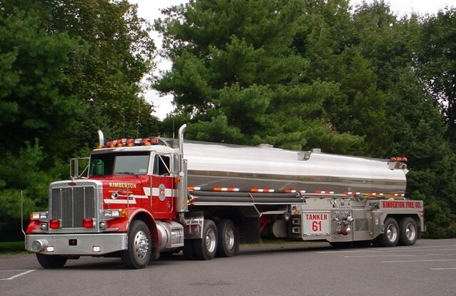
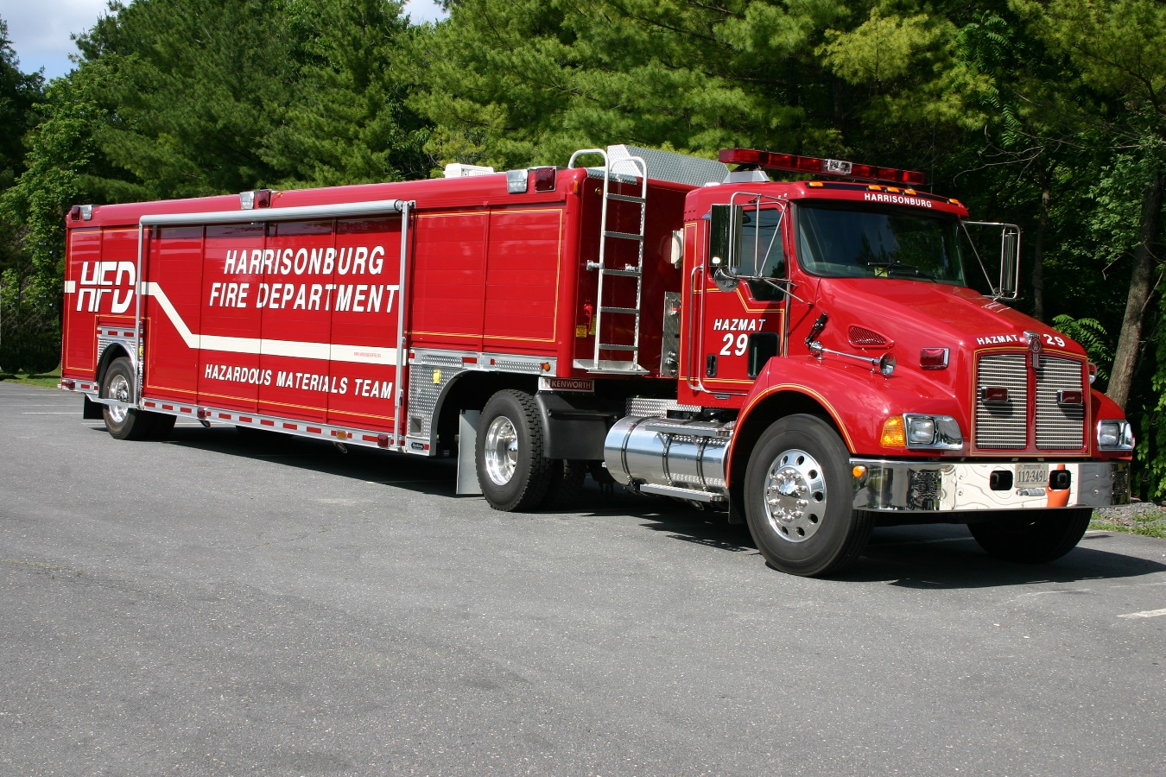
Class 4 Vehicles
1-20
Notes:
Updated Photos

Slide 22
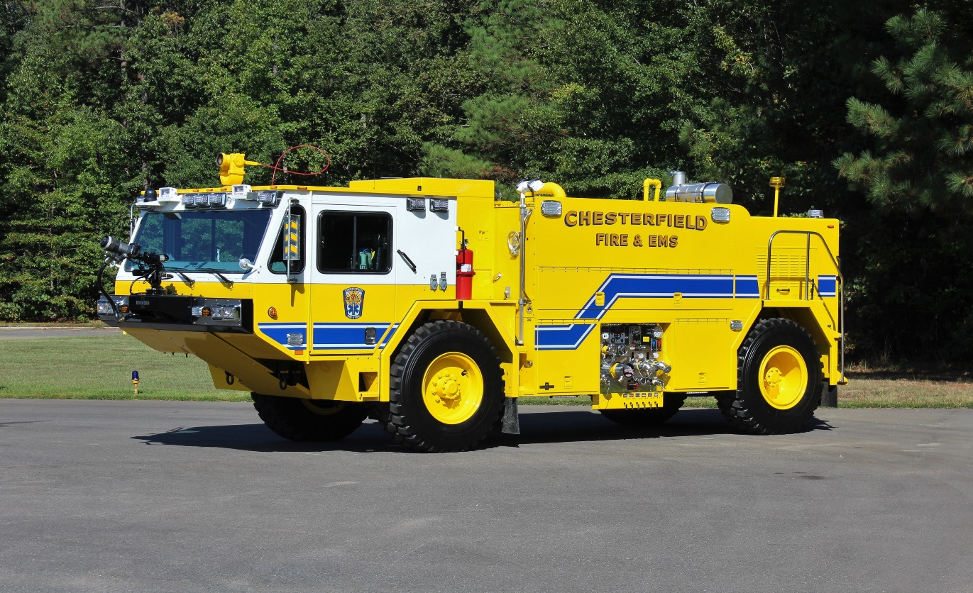
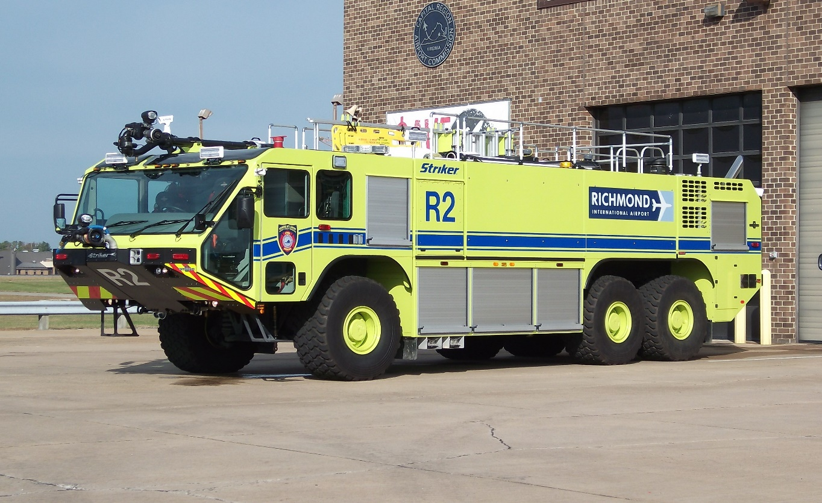
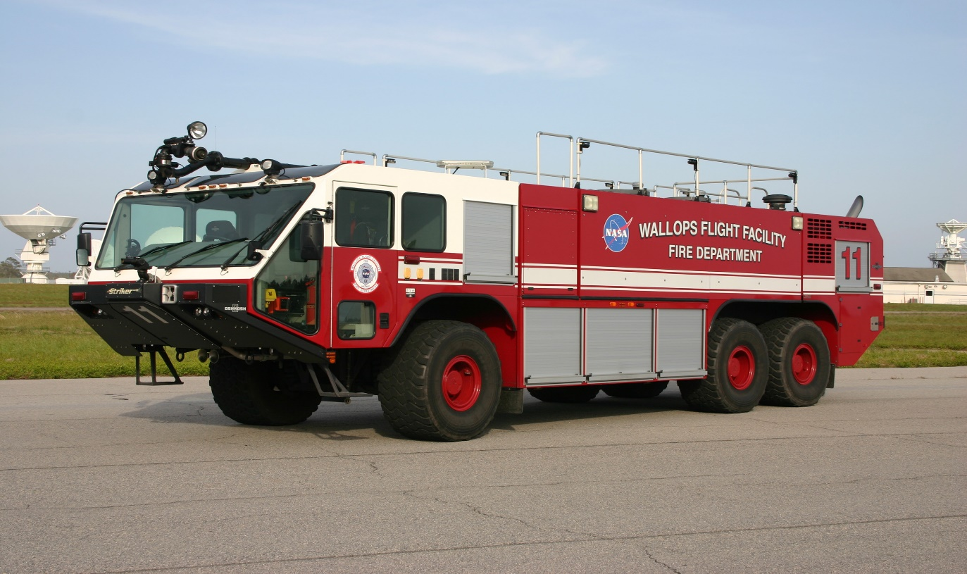
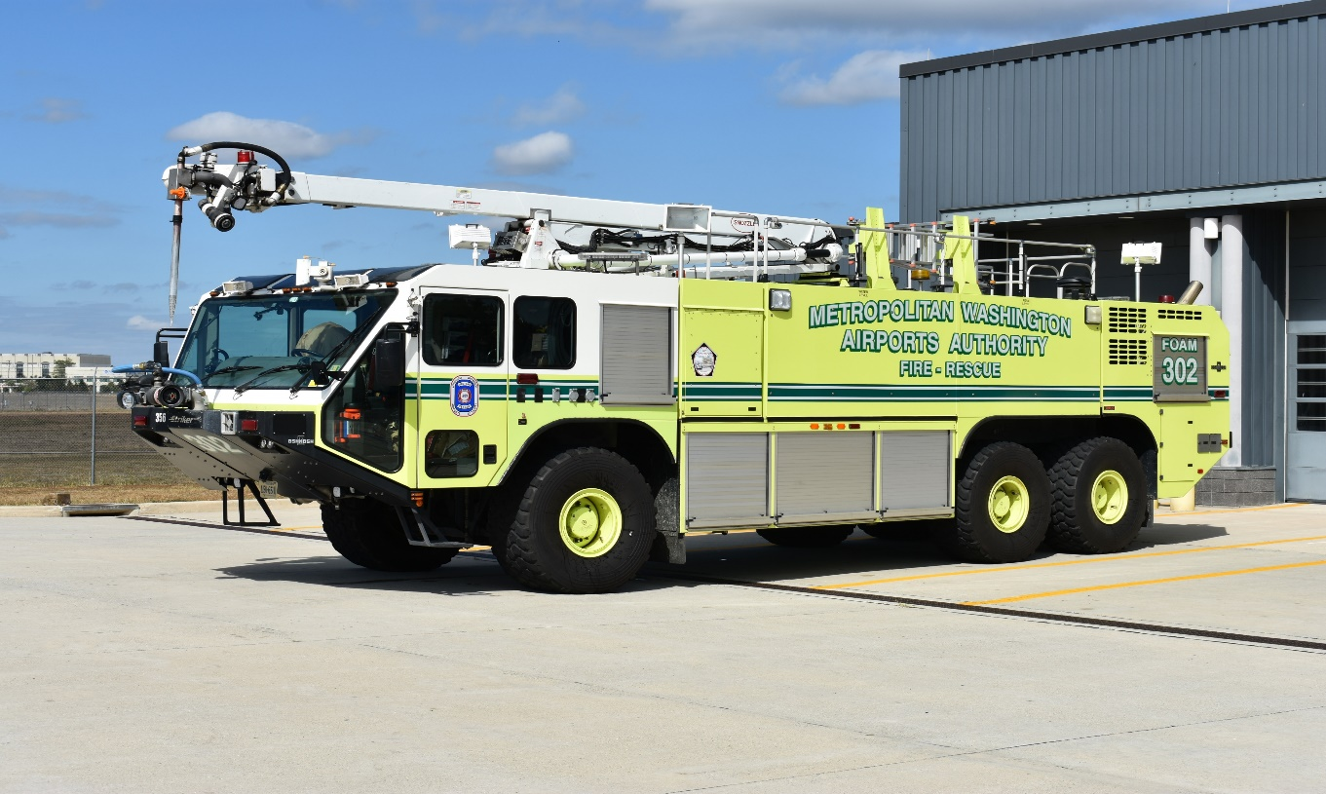
Class 5 Vehicles
1-21
Notes:
Updated Photos

Slide 23
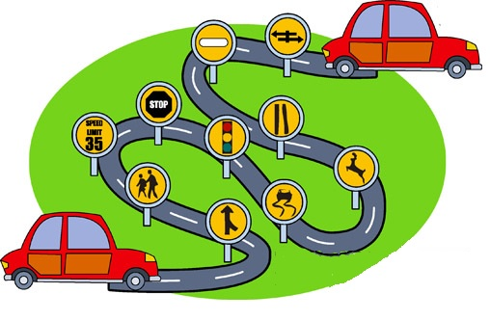
Desirable Student Attributes
Skills
  Reading
  Writing
  Mechanical
Physical Fitness
  Vision
  Hearing
  Disabilities
1-22
Notes:
These are minimum attributes required by the Virginia DMV for driver license requirements

Slide 24

Driver Selection
  Often selected through promotions
  Often selected based on experience, training and certification requirements.
  Drivers must have desire and put forth an effort to learn
1-23
Notes:
Again, remind the students that the agencies designate drivers and have requirements beyond competition of this basic EVOC course.

Slide 25
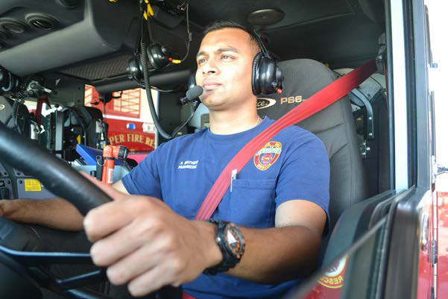
Driver Selection
Requirements
  Agency / Department
    Insurance
    Age
    Training
  NFPA Standards
    1001
    1002
    1500
1-24
Notes:
NFPA 1001-Firefighter 1 & 2 Certification Standards, 1002-Driver Standards and 1500-Occupational and Safety Standards. Agency protocols/procedures have specific requirements regarding age and insurance as well as training requirements beyond basic EVOC certification

Slide 26
Statistical Information
*Studies show that people
without driver training experience
are involved in 62% more crashes
than those who have attended
driver safety courses.
Such training can, for you,
establish and maintain lower insurance costs, increase ability to avoid crashes, and
lessen the degree of the crash should one occur.
*Source – US Fire Administration EMS Safety
1-25
Notes:
We offer EVOC training because the results of comprehensive training is a reduction in motor vehicle crashes and emphasizes safety of personnel.

Slide 27
Additional Information
  Advanced behind-the-wheel driver training teaches drivers to drive more defensively.
  Trained operators can anticipate the actions of other drivers on the road and avoid situations that could cause a crash.
  Drivers learn to position themselves better in traffic, stopping and starting less often and causing less wear and tear on agency vehicles.
  Additionally, driver training can result in better fuel economy and lower overall maintenance costs.
1-26
Notes:
Take the training seriously and give your full attention to course content and the information that is covered.

Slide 28
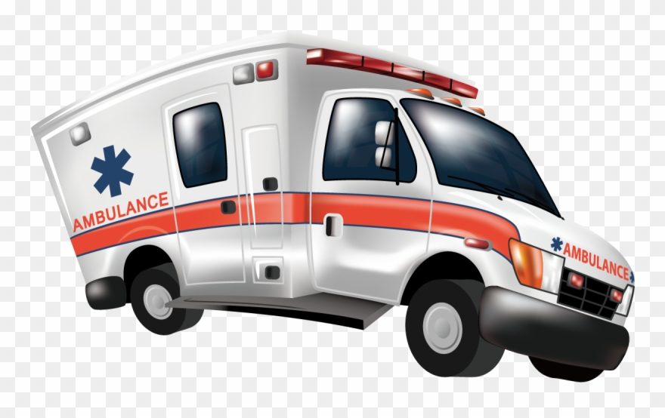
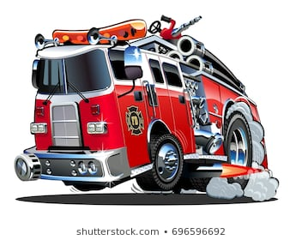
Statistical Information
*Research has shown, approximately 95 percent
of all 911 EMS calls ARE NOT true emergencies.
Of the rest, less than 3 percent turn out to be
life-threatening or potentially life-threatening.
*Source – US Fire Administration EMS Safety
1-27
Notes:
Bottom line – in a vast majority of emergency responses speed is not necessary.

Slide 29
Public Relations Concern
You are your agency’s best or worst public relations agent.
The public views you more while you are driving than at any other time.
1-28
Notes:
Show respect to the public and other drivers. Be alert that how you drive is being watched at all times.

Slide 30

Good Public Relations
  Safe driving displays professionalism and respect for the public
    Show courtesy
    Keep vehicles clean
    Initiate and maintain
    public information programs
1-29
Notes:
Always remember you represent your agency and the community and have a responsibility to protect life, limb and property.

Slide 31
Bad Public Relations
Vehicle crashes involving emergency services vehicles may have serious consequences.
  Emergency efforts are delayed to the original scene
  A second emergency scene is created
  Vehicles and property may be damaged
  Potential for injuries to personnel and the public
  Public image of your department suffers
  Driver / Department may be subject in a lawsuit
1-30
Notes:
Driver safety should be part of a regular conversation at training sessions.

Slide 32

Additional Bad Public Relations Issues
  Improper languages; gestures
  Unkempt appearance
  Driving recklessly
  Impatience in dealing with the public
1-31
Notes:
Bad PR affects donations and community support for your agency.

Slide 33
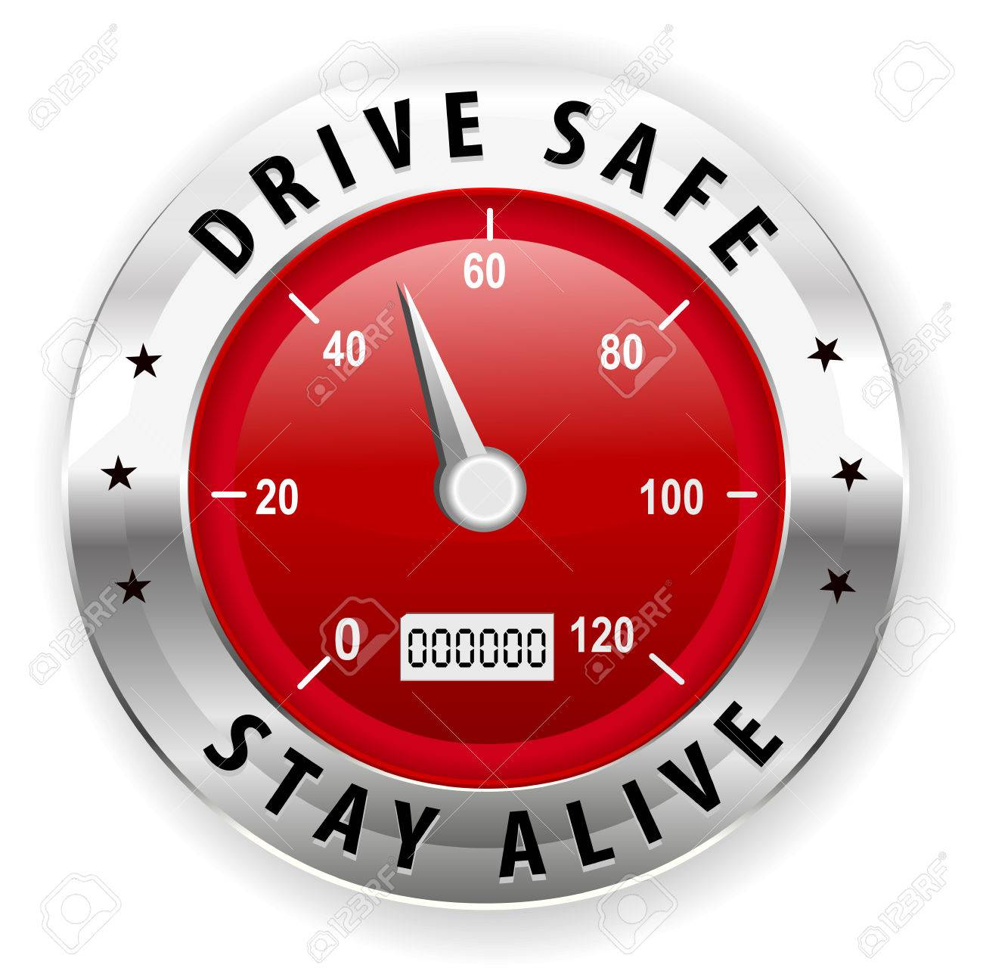
Defensive Driving
Driving to prevent
crashes in spite
of incorrect actions
of others or adverse
conditions.
“Distracted drivers make this more important than ever”
1-32
Notes:
Driving to save lives, time, and money, in spite of the conditions around you and the actions of others – transition: “Distractions make this more important than ever”
We live in a society that engages in many distractions while behind the wheel. In other words they practice “Offensive Driving”. We must be on the defensive at all times when we are on the road. That can be exhausting. Often we have a partner in the cab with us that can help navigate around these hazards. Remember, two set of eyes are better than one. Some logical pointers for safer driving will be covered in the following slides.

Slide 34
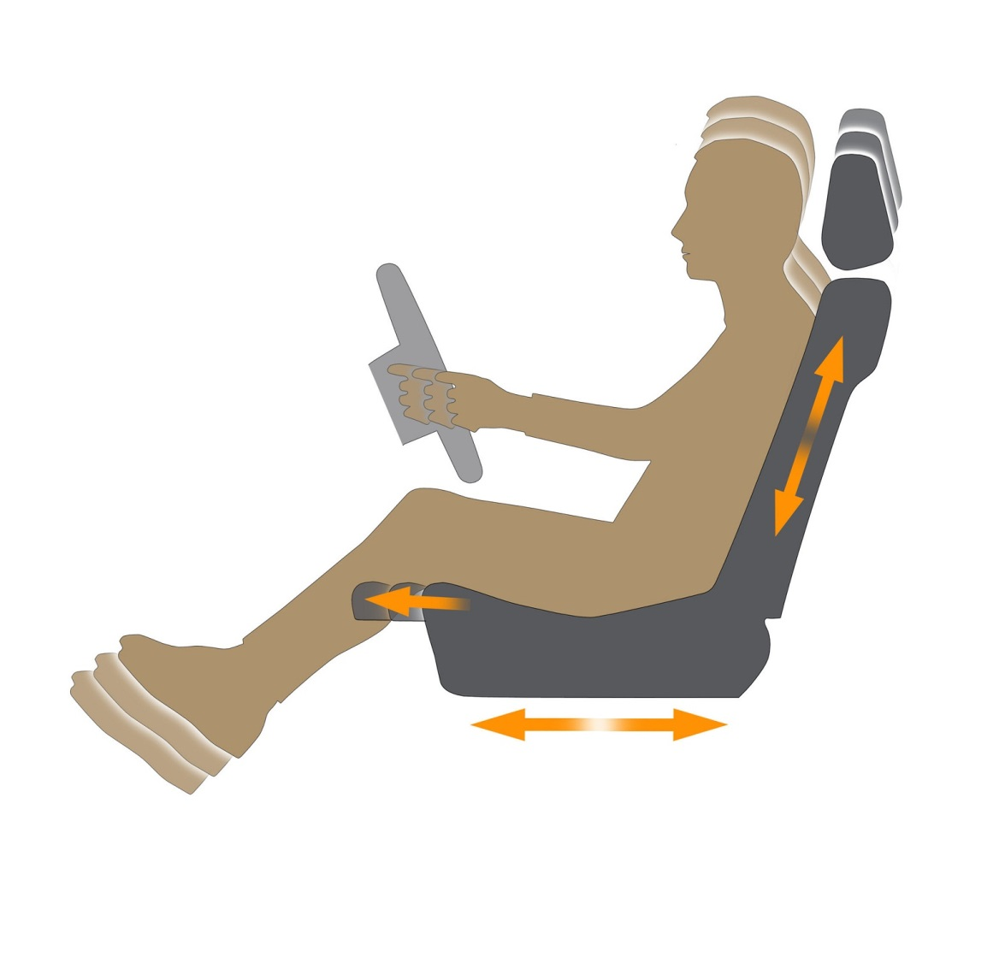
Seat Adjustment
  Proper hand positioning
  Legs slightly bent at knees
  Proper seat height
1-33
Notes:
Put yourself in a position to be able to reach controls and pedals.

Slide 35
Position and Use of Feet
Right Foot
  Placed squarely over accelerator
  Over brake only in anticipation of braking
Left Foot
  Never used for braking
  Rest on floorboard to assist with balance
1-34
Notes:
Do not ride the brake or rest either foot on the brake pedal

Slide 36

Position of Hands
Holding the wheel
  Firm grip with both hands
  Do not let wheel spin freely
  Do not palm the wheel
  Do not allow wheel to slide through hands
1-35
Notes:
Develop good habits in driving by always driving with two hands.

Slide 37
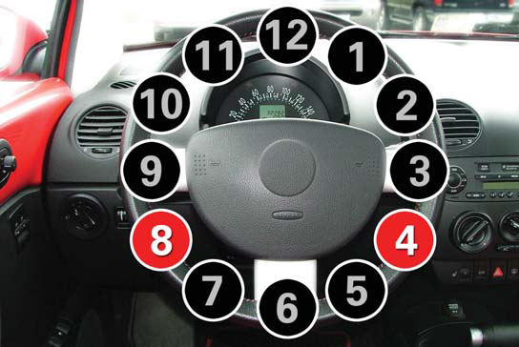
Proper Hand Position
Sit straight but relaxed and place your hands on the steering wheel. If your steering wheel were a clock, your hands should be at the 8 o’clock and 4 o’clock positions. Hold the wheel with your fingers and thumbs. Avoid gripping it with your palms. (pp 13-Virginia Driver’s Manual)
1-36
Notes:
Taken from the Virginia Driver’s Manual. This hand position should be used in the student’s personal vehicle as well as when driving an emergency vehicle.

Slide 38
Shuffle Steering
  Hands do not cross each other
  Both hands remain in contact with wheel at all times
  Used for turns and for counter-steering
  Becomes more comfortable with practice
1-37
Notes:
Give it a legitimate try – shuffle steering gives your patient/crew and comfortable ride and also controls vehicle dynamics by keeping the vehicle stable.

Slide 39
Vehicle Mirrors
Drivers need to utilize mirrors effectively!
Adjustments
    When possible, completed prior to moving vehicle
    Allow vision of side of vehicle and as much of lane as possible
    Use convex mirrors to get the “big picture”
1-38
Notes:
Adjust your mirrors to eliminate as many blind spots as feasible.

Slide 40

Blind Spots
  Know location of your vehicle’s blind spots – each vehicle is different
  Compensate by using others to assist you
  When possible, use spotter(s) while backing
1-39
Notes:
If another vehicle “hangs out” in your blind spot, slow down and let them pass.

Slide 41
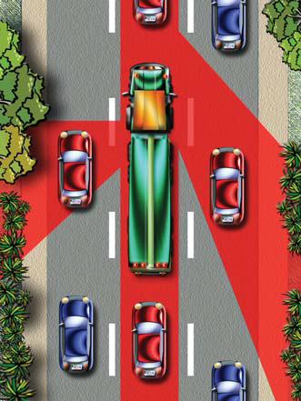
Blind Spots / “No Zone”
  Don’t “hang out” on either side of large vehicles.
  Don’t tailgate.
  Pass safely
  If you cannot see the driver, they can’t see you.
Virginia Driver’s Manual
1-40
Notes:
Graphic is from Virginia Driver’s Manual – make sure YOU do not hang out in the no zones.

Slide 42
Signaling
  Every driver must legally use signals to assist others in knowing what their intentions are.
  “Do Not” use hazard (four-way) flashers while moving – most turn signals do not operate while hazard flashers are on.
  Fire apparatus and ambulances must be equipped with backup alarms.
  Sound horn prior to backing as an additional precaution.
1-41
Notes:
It is our responsibility to advise the driving public our intentions: stopping, turning and backing!

Slide 43
Braking
Only accomplished with right foot.
Gradual steady pressure on pedal.
Engine retarders or engine brakes help in vehicle control.
  Reduce excessive brake wear.
  Follow manufacturers recommendations for wet / slippery roads.
1-42
Notes:
Respect your brakes – don’t over estimate their capabilities.

Slide 44
Braking
Some air brake systems have limiting valves for varying road conditions
  Dry Road versus Slippery Road
  NTSB recommends that their use on emergency apparatus be discontinued
Abrupt stops can cause injury, mechanical failure and skidding
1-43
Notes:
Know your equipment and practice with each vehicle you will be authorized to drive.

Slide 45
Braking
Avoid locking-up brakes
  Requires a greater distance to stop
  Interferes with steering control
Most vehicles are equipped with Anti-Lock Braking Systems (ABS)
1-44
Notes:
Do not pump the brakes on vehicles with ABS. If you lock-up the wheels you will loose steering control so the ANTI-LOCK nature of the braking system is extremely important to understand.

Slide 46
Braking
** IMPORTANT NOTE **
Anti-Lock Brakes require a steady pressure applied to the pedal.
DO NOT “pump” the brake pedal on vehicles equipped with Anti-Lock Braking Systems!
1-45
Notes:
Again – DO NOT PUMP THE BRAKES

Slide 47
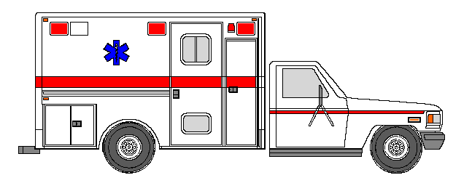
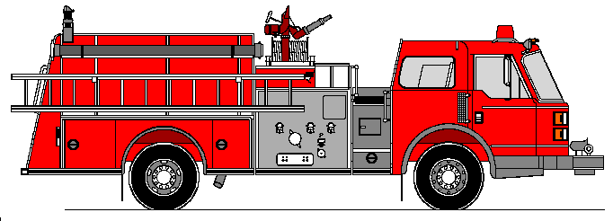
Stopping Distance Formula
R.D. + B.D. = S.D.
Reaction
Distance
Braking
Distance
TOTAL STOPPING DISTANCE
Reaction Time = 3/4 Second
Braking Distance
INCREASES
with vehicle SIZE and SPEED
1-46
Notes:
The higher the weight of the vehicle the longer it takes to bring it to a stop. Slow down when you anticipate a need to come to a stop.

Slide 48
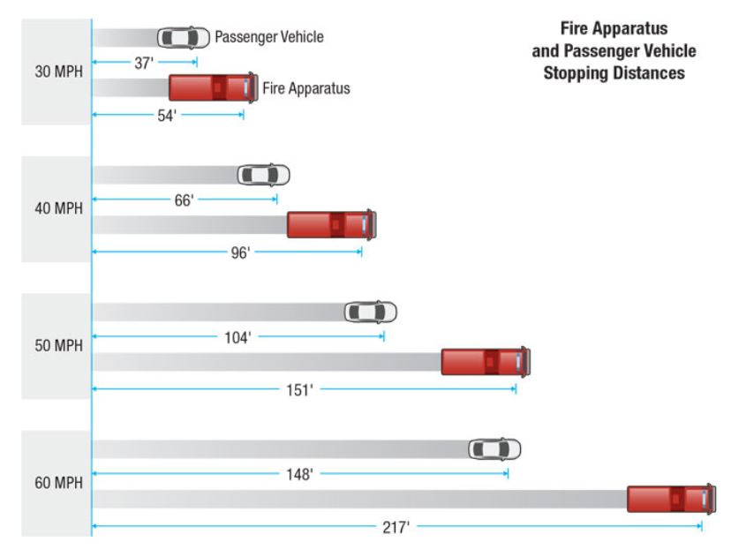
Braking Distance
Virginia Driver’s Manual
1-47
Notes:
Good graphic that helps you visualize the increased length of the braking distance of large vehicles.

Slide 49
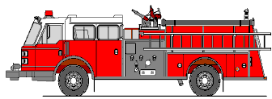

FOLLOWING DISTANCE FORMULA
3 SECOND RULE
1001, 1002, 1003
WHEN DRIVING LARGER VEHICLES YOU MUST INCREASE YOUR FOLLOWING DISTANCE!
1-48
Notes:
Probably a rule you learned in driver’s ED – still applicable today.

Slide 50
Stopping Distance vs. 3 Second Rule
Heavy Two-Axle Trucks
MILES
PER
HOUR
20
30
40
50
60
FEET
PER
SECOND
30
45
60
75
88
TOTAL
STOPPING
DISTANCE
62 feet
125 feet
209 feet
310 feet
436 feet
3 SECOND
SPACE
90 feet
135 feet
180 feet
222 feet
264 feet
AS SPEEDS INCREASE
AND VEHICLE SIZE INCREASES
INCREASE YOUR FOLLOWING DISTANCE
1-49
Notes:
Good visual of the increased stopping distance of large two axle vehicles.

Slide 51
Visual Lead Time
The time and space allowed around your vehicle for response to a hazard.
    The 12-Second Rule - By watching for possible road hazards 12 seconds ahead, drivers will have more of a chance to avoid a collision.
      Distance you should be aware of hazards
      Being aware of what is ahead and behind
      Same principal as the 3 second rule
      Increase the distance with speed
1-50
Notes:
Just like the 3 Second rule except it applies to “getting the big picture” by staying alert to what is in your field of vision in front of you.

Slide 52
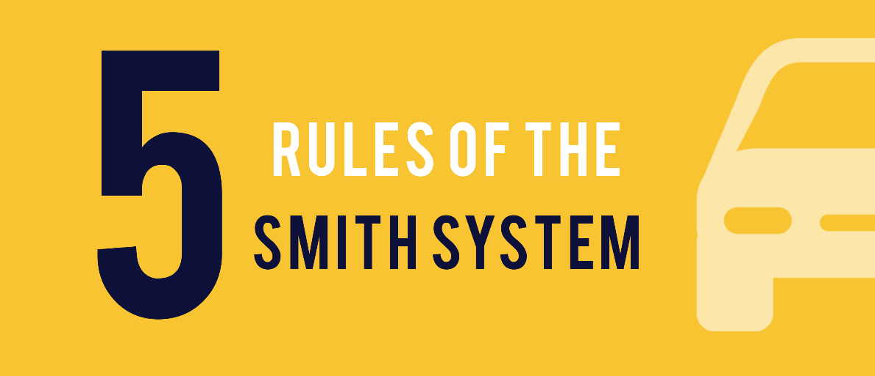
The Smith System
Five Principles of Safe Driving
  Aim high in steering
  Get the big picture
  Keep eyes moving
  Allow an out
  Keep vehicle visible
1-51
Notes:
We will break down each of these five principles – use this information to improve your defensive driving and avoid collisions.

Slide 53
Five Principles of Safe Driving
The Smith System states that following these five rules can dramatically reduce the risk of major accidents on highways and roads.
Aim High in Steering
The driver should focus their attention high –
- VIEW THE WHOLE ROAD.
Get The Big Picture
“Be aware of your surroundings at all times”. Having the whole picture means that you are doing your part to keep your vehicle as safe as possible while moving 1,000 feet a second.
1-52
Notes:
Allow students to read the information –
Aim High
The driver should steer and focus their attention high, so as to view the road as whole and not just a few feet ahead. The first rule of the “Smith System” means to stay alert of the dangers and traffic ahead because it not only avoids rear-end collisions, but it also alerts other drivers behind your vehicle to slow down.
The Big Picture
“Be aware of your surroundings at all times” may seem obvious to say, but distracted drivers are just as dangerous as intoxicated ones. Erratic and angry drivers take up a large portion of the traffic we see daily, so avoid major accidents by noticing how other drivers behave on the road. Having the whole picture means that you are doing your part to keep your vehicle as safe as possible while moving 1000 ft a second. There are a variety of hazards between your own vehicle and other drivers, and a keen awareness of these dangers will reduce these risks.

Slide 54
Keep Your Eyes Moving
Remain alert consistent eye movement prevents your body from entering the trance state, keeping you alert to every driving condition ahead of you.
Allow An Out
Don’t let other drivers box you in while selecting their lanes. Always anticipate what choices other drivers make.
Keep Vehicle Visible
The final rule for the Smith System prevents accidents by removing assumptions made behind the wheel. As a driver, make sure that other drivers can see you and anticipate your move. If you feel you are coming into another driver’s blind spot, use the horn to get their attention.
1-53
Notes:
Keep Your Eyes Moving
The third standard of the Smith System asks drivers to remain alert. Energy drinks can only do so much before they cause the body to crash, and any repetitive motion sends us into a trance. Consistent eye movement prevents your body from entering the trance state, keeping you alert to every driving condition ahead of you.
Leave Yourself an Out
This means ensure that other drivers do not box you in while selecting their lanes. Do not follow other vehicles too closely, and always anticipate what choices other drivers make.
Make Sure They See You
The worst thing a driver can do is assume. Assume other drivers can see them, assume other drivers are not dangerous, or even assume that they will just get to their destination safely. The final rule for the Smith System prevents accidents by removing assumptions made behind the wheel. As a driver, make sure that other drivers can see you and anticipate your move. If you feel you are coming into another driver’s blind spot, use the horn to get their attention.

Slide 55

S-I-P-D-E
A five-step approach to safe driving behaviors
  Scan (Sense & Search)
  Identify
  Predict
  Decide
  Execute
1-54
Notes:
Read the information about each of the letters in the acronym SIPDE that is on the graphic.

Slide 56
Sirens
Usage specified by Virginia Motor Vehicle Code (used with “reasonable necessity”)
Be Aware that sudden usage behind a vehicle may startle the driver
Better response to sounds that change pitch often
1-55
Notes:
We will cover the Code of Virginia’s requirements for siren usage during Session 2.

Slide 57
Sirens
Short bursts of air horns and constant up and down siren oscillation most effective
Emergency vehicle operators must be aware of other emergency vehicles
  Difficulty in hearing sirens of other emergency vehicles
  Report approach to common intersections by radio
1-56
Notes:
Think of siren use as a way getting attention of other drivers and advising them or our REQUEST for the right of way and not a DEMAND.

Slide 58
Siren Projection
> > > >
40 MPH
300 FEET EFFECTIVE
> > >
60 MPH
12 FEET EFFECTIVE
KEY POINT: DON’T OUTRUN IT
1-57
Notes:
Also, the point is unless our siren gets the attention of other drivers and pedestrians we cannot expect them to yield the right of way.

Slide 59
Disadvantages Of Siren Use
On Highways / Interstates
Traffic normally moving at speeds equal to or greater than safe response speed
Vehicles stopping or trying to get out of the way can cause serious crashes and traffic jams
Evaluate the legal implications of not using siren
1-58
Notes:
Think about it, most of the other vehicles on the Interstate are traveling at speeds faster then most large apparatus are capable.

Slide 60
Vehicle Color
Traditional
Versus
Safety
USDOT Regulations / NFPA Standards
1-59
Notes:
Although we are not advising agencies to change the color of their vehicles we do recommend when new apparatus are purchased they should give color great consideration with regard to visibility.

Slide 61
Does Color Make A Difference At Night?
BE SAFE, BE VISIBLE
1-60
Notes:
Make sure the lights in the room are low to get the full effect of this visual.

Slide 62

Seat Belts
Safety of others in the vehicle is
the driver’s responsibility
  Be fully dressed before getting on
  All riders should wear seat belts
  Shall be seated and not permitted to stand
  Riding on tailboard is UNSAFE and is NOT ACCEPTABLE
1-61
Notes:
Virginia Law will be covered during the law section of the course – but basically requires all occupants in the cab to be belted.
Driver is require to assure everyone and everything is secured.

Slide 63

Passenger Restraints
Patient Compartment:
  Always alert the driver when you are unbelted and providing patient care.
Supplemental Restraint Devices / Systems
  Air Bags
  Seat Belt Pre-Tensioners
1-62
Notes:
Ask the group – “Do you use seat belts every time you drive?
It is the law! “Click it or Ticket!”
Remember many vehicles have supplemental restraint systems.

Slide 64



Securing Occupants and Equipment
Everyone and everything restrained
1-63
Notes:
“Everyone & Everything Restrained”.
Purpose: The risk of occupational injury and death is disproportionately high for EMS personnel and the majority of those casualties are associated with transportation incidents. Simply put, ambulances are not built or used the same manner as standard passenger vehicles, resulting in safety concerns for both caregiver and patient. While there are inherent risks to occupants in an ambulance, some of the vulnerability can be reduced by properly restraining occupants and equipment.

Slide 65

NIOSH Video
Squad bench view of 30 mph crash
Click on the video to play and replay
1-64
Notes:
Video: Interior view of same crash test. Medic on your left is unrestrained. Medic on right is wearing lap belt. Patient is fully secured, including shoulder restraints.
64

Slide 66

Adult Patient Restraint
Challenges
  No single position works for all patients
  Comfort issues
  Medical equipment in use
  Limitations of equipment
1-65
Notes:
Why is it difficult to restrain adult patients? Some factors include: No one position works for all patients. Patient comfort issues. Medical equipment in use. Limitations of our own equipment.
As appropriate you might have a class discussion about the patient in this picture and the usefulness of the shoulder straps especially since she is sitting upright.

Slide 67


Stretcher
Make sure it is
properly secured
  Completely secure in mounts
  Patient faces rearward
  Patient’s head elevated when possible
1-66
Notes:
Discuss importance of patient stretcher based on these four items: MUST be completely secure in its mounts. Ideally, patient faces rearward. Head should be elevated, when appropriate for patient condition. The stretcher/cot is the preferred patient location because the patient can be sitting up versus the side-facing bench seat.

Slide 68

NIOSH Video
Overhead view of a 30 mph crash
Click on the video to play and replay
1-67
Notes:
Video: same crash test as before, overhead view.
67

Slide 69



Patient Stretcher Restraints
It is important to always use restraints properly
Used per manufacturer guidelines
Secure and snug
Must use shoulder restraints
Only for patient
Complacency is
dangerous and unacceptable
1-68
Notes:
Review importance of using straps with these 5 important items: All restraints must be used per manufacturer guidelines. Straps should be secure and snug. Shoulder restraints are a MUST! Use the patient restraints only for the patient – not equipment –during vehicle travel. Complacency is dangerous and unacceptable. Virginia EMS Rules and Regulations require it, so should you!
It is better to use shoulder straps, despite their limitations, than to not use them at all.

Slide 70

Potential Projectiles
Collision
Rollover
Sudden Deceleration
1-69
Notes:
Ask students, “What are some potential objects that could become projectiles during a collision and or sudden deceleration or rollover?”
Some potential projectiles: Oxygen bottles, Cardiac monitors, Jump kits, Radios, Computer laptops/tablets, Sharps containers.

Slide 71

Potential Projectiles
  PPE Gear
  Patient Belongings
  Medical Devices
  Personal / Firefighting Gear
  Wheelchairs
  Flight Team Equipment
1-70
Notes:
Image explanation: ambulance was involved in a crash, item on floor were either loose in the patient compartment or fell from compartments in the crash. Any of these additional items could become projectiles during a collision and or sudden deceleration or rollover. To the extent possible store these items in exterior compartments.

Slide 72
Securing Equipment
“Do”
  Assure all normal daily equipment has its place and is routinely secured
  Use cabinets and brackets
  Secure needed equipment in reach
  Select soft over hard kits
  Store unnecessary items in exterior compartments
  Have extra belts to secure “surprise” items
  Plan ahead
1-71
Notes:
Review this list of securing equipment “DO” items:
Assure all normal daily equipment has its place and is routinely secured
Use cabinets, straps and brackets to secure items
Secure needed equipment in reach, when possible
Select soft over hard kits that a routinely used in the patient compartment
Stow unnecessary items in exterior compartments
Use seatbelts or straps to secure “surprise” items
Plan ahead to avoid last minute complacency

Slide 73
Securing Equipment
“Don’t”
  Leave hard or heavy items unsecured
  Transport unnecessary items
  Secure equipment with restraints intended to secure patient
  Get complacent with small hard items
1-72
Notes:
Review this list of securing equipment “DON’T” items
Leave hard or heavy items unsecured while in motion
Have unnecessary items in the patient compartment
Attempt to secure monitors and oxygen bottles with restraints intended to secure your patient
Get complacent – laptops, portable radios and other small, hard items can be deadly projectiles

Slide 74
Occupants and Equipment
Final thought about securing everyone and everything
“First Responders must do a better job securing ourselves, patients and equipment. We often see the adverse results of others who don’t use seatbelts or child seats, so let’s set the standard.”
“LEAD BY EXAMPLE”
1-73
Notes:
Just a thought to leave them with regarding securing everything and everyone.

Slide 75



The Transportation System
The transportation system is made up of three (3) components:
The Vehicle
The Driver
The Environment
1-74
Notes:
Announce that we will discuss each of the Transportation System’s components in detail. Each student should reflect on what aspects of these components they can control.

Slide 76
The Vehicle
Daily Maintenance Checks
  Accomplished at the beginning of shift if possible
      Approaching the vehicle
        Is the vehicle clean
        Is the vehicle sitting level
        Fluid leaks underneath
        Condition of glass and lights
        Tire condition
1-75
Notes:
Advise the students to be diligent with their vehicle checks and not take anything for granted with regard to the safety of themselves, crew or patient.

Slide 77
The Vehicle
  Engine Compartment Checks
    Fluid checks – oil, power steering, cooling system, brake, transmission, windshield washer
    Batteries, hoses, and belts
    Refer to manufacturer’s recommendations
1-76

Slide 78
The Vehicle
  Cab Compartment Components
    Controls and gauges
    Seat adjustment, mirror adjustment, and seat belts
    Equipment secure in cab
    Windshield clean
1-77
Notes:
Be a strong proponent of a clean windshield. Debris, bugs, bird droppings and other things will be a visual distraction during operation of the vehicle.

Slide 79
The Vehicle
  System Checks
    Lights, gauges, wipers, radios
    Emergency equipment (lights, sirens, air horns, etc.)
1-78
Notes:
The check should involve the entire crew.

Slide 80
The Vehicle
  Equipment In Compartments
    Properly stored and secured
    Cleanliness
    Proper working order
1-79
Notes:
Keep compartments clean and well organized.

Slide 81
The Vehicle
  Road Check
    Steering
    Transmission
    Brakes and suspension
      Document all defects and/or needed repairs
1-80
Notes:
Report all defects and do not take chances if issues are noted.

Slide 82
Sample Inspection Report
1-81
Notes:
Sample vehicle inspection report – do not “pencil-whip” the form. Fill it out with integrity – like your reputation is dependent upon it-because it is!

Slide 83

The Vehicle
Maintenance –
Weekly / Monthly
Same as daily but with greater detail – checks of all components and inventory
Check undercarriage for leaks and/or loose connections
1-82
Notes:
During monthly checked – nothing should go unchecked.

Slide 84






Vehicle Dynamics
Vehicle Size
1-83
Notes:
Different vehicles – Different Dynamics – know your vehicle.

Slide 85
Vehicle Dynamics
Weight and Height
  Vehicle dynamics change as weight and height changes
  Four-wheel drive vehicles
Common Causes of Weight Transfer
  Drivers must become familiar with the normal handling characteristics of their vehicles
1-84
Notes:
Ambulances are traditionally “top heavy”. Know your limitiations.

Slide 86
Starting and Driving The Vehicle
Follow manufacturers recommendations for starting, driving, and operating emergency vehicles.
Driver should review incident location, response route, and other pertinent factors prior to responding.
Ensure all personnel are dressed and seated with seat belts on prior to moving.
1-85
Notes:
Use the information in the vehicle manual – knowledge of your response route aids in your ability to control your vehicle.

Slide 87
General Driving Practices
Drivers must become familiar with normal operating and gauge readings associated with each vehicle.
  Drivers must be thoroughly familiar with operator’s manual and consult them for permissible limits when in doubt.
Engine shutdown should never be made immediately after full-load operation.
  Allow hot engine to idle until cool. Do not race engine prior to shutdown. Turbochargers must cool or severe engine damage will result.
1-86
Notes:
KNOW WHAT THE GUAGE READINGS MEAN – always let the vehicle cool down after an emergency response.

Slide 88


The Driver – Attitude
The most important factor that you control in emergency vehicle operations is Driver Attitude!
The number one cause of vehicle crashes is
Driver Error or Driver Inattention.
1-87
Notes:
It is a proven fact – you will drive an emergency vehicle is a similar fashion that you drive your own vehicle – some of those attitudes and habits will need to change.

Slide 89
The Driver – Attitude
Pitfalls
  Overconfidence
  False ideas
  Impatience
  Tension
  Exhibitionist
  “Road Rage”
Professionalism
  Maturity
  Responsibility
  Courtesy
  Desire
  Restraint
1-88
Notes:
Be professional and avoid these pitfalls.

Slide 90



Distraction Free Driving
Human aspects we can control
1-89
Notes:
Distractions increase the risk of collisions. These (music, conversation, sight seeing, cell phones, GPS) are the Human Aspects that we can control when we are driving. When are any of these distractions appropriate and when are they not?

Slide 91
Types of Distractions
Visual
Auditory
Biomechanical
Cognitive
  Text Messaging
  “Protective” Distractions
1-90
Notes:
Each will be covered in slides that follow

Slide 92

Visual Distractions
Things that take your eyes off the road
1-91
Notes:
Visual distractions, these things take your eyes off the road. Ask students, “what are examples of visual distractions?”

Slide 93




Auditory Distractions
Sounds that attract your attention and your eyes off the roadway
1-92
Notes:
Auditory distractions are sounds that take your mind off the road.
Ask students, “What are some examples of auditory distractions?”
child/occupants
siren
cell phone alerts
pager alerts
radio tones
DVD players
CD players
radios
etc.

Slide 94

Biomechanical Distractions
Things that take your hands off the wheel
1-93
Notes:
Biomechanical distractions are things that take your hands off the wheel.
Ask students, “what are some examples of biomechanical distractions?”
Anything that requires manual control
GPS
Computer
Emergency Radios
Siren controls
Rear view cameras
Etc.

Slide 95

Cognitive Distractions
Thoughts that take your mind off the road
After work I have a lot of errands to run.
1-94
Notes:
Cognitive distractions are things that take your mind off the road.
Ask students, “What are some examples of cognitive distractions?”
An argument you just had.
Shopping list
Errands you need to run
Personal issues/problems
Etc.

Slide 96

Text Messaging
Is the perfect storm of distraction
  Visual, manual, and cognitive distractions all in one.
Let me read and respond to these messages.
1-95
Notes:
Texting is a "perfect storm." It requires you to: Look at the keyboard (visual), manually manipulate the keys (biomechanical/manual), alert tones (auditory), think about what you're writing (cognitive).
This means texting is a visual, biomechanical, auditory, and cognitive distraction all in one.

Slide 97

Text Messaging
Highest risk of crashing
1-96
Notes:
Discussion of the magnitude of the risk related to texting. Ask students, “how many have responded to a texting related crash?” Data from Virginia Tech shows that texting increases your odds 23.2 times of having a crash.

Slide 98

“Protective” Distractions
Some improve safety – Example “Clear Right.”
Car coming out of driveway on the right. You got it?
1-97
Notes:
Some distractions actually improved safety and may have a protective effect, such as talking to a passenger or adjusting the radio, may help combat fatigue. Passengers also may serve as a collision warning.
When you have a partner riding “shotgun”, they should always assist you at intersections by assuring the right-of-way is available to you

Slide 99


Distracted Driving
Habits need to change!
Let’s have a discussion…..
“What are some examples of ways to prevent driving distractions?”
1-98
Notes:
Ask students, “What can we do to combat distracting driving?”
As needed, these are 10 things you can do today to combat distracted driving:
Leave your phone on silent, and out of reach, only check for messages when your vehicle has been placed in park
Have your partner answer your phone or reply for you
If you need to have a phone conversation or text, have your partner drive
Secure all objects
Have your partner navigate or plan your route before driving
Have your partner handle the radios when possible
Talk on the radio only when safe to do so, i.e.: prior to placing the vehicle in drive, at red lights, etc..
Place any object that you feel may distract you, out of sight and reach
Pull over to the side of the road if you feel the need to deviate from a safe practice
Don’t drive drowsy
*Don’t forget that other drivers may be distracted behind the wheel.
Stay alert and stay away from those that are blinded by distraction!

Slide 100

Fatigue
Effects of Fatigue
  Slowed motor skills
  Delayed reaction time
  Poor concentration
  Bad judgement
  Blurred vision
  Driving too slowly or fast
  Driving across lanes
  Rolling stops
  Agitation and /or impatience with other drivers.
1-99
Notes:
24 hour shifts, long transports and back-to-back-to-back responses challenge our body systems and can easily fatigue our performance, especially driving.

Slide 101

The Driver – Mental Fitness
Operation of an emergency vehicle often involves high speeds, driver stress, and danger to life and/or property.
Driving under emergency conditions requires extra sensitive judgment and refined driving skills.
1-100
Notes:
BE ALERT – driving a emergency vehicle requires 100% of your attention. Focus on the task and always work to refine your driving skills.

Slide 102
The Driver – Mental Fitness
Personal habits – behavior patterns developed through repetition
Knowledge
Judgment
Stress and reaction to stress
Experience – continued practice of good driving habits on which the driver can rely
1-101
Notes:
A list taken right from the Virginia Driver’s Manual.

Slide 103
The Driver – Mental Fitness
Substance Abuse – commonly seen in high stress positions
  Researchers estimate that between the hours of 10 PM and 2 AM three out of every ten drivers are drunk.
  Nearly 50 percent of the drivers arrested for DUI are social to moderate drinkers. Don’t think that it won’t happen to you.
  Coffee does not speed up the elimination of alcohol and/or other substances from the body
1-102
Notes:
A no tolerance rule for substance use that affect the operation of a motor vehicle or machinery is an absolute necessity.

Slide 104

Physiological Aspects
Visual Perceptions
90% - 95% of all incoming data is obtained through VISION!
1-103
Notes:
Tired, red eyes will limit your ability to take in all of the information that is necessary for your brain to make great decisions.

Slide 105


Physiological Aspects
Visual Perceptions
  Eye sight
  Glare recovery
  Depth perception
  Peripheral vision
1-104
Notes:
Avoid looking directly at bright lights during night driving. If your pupils are allowed to fully constrict you will be driving “blind” when the light passes.

Slide 106
Physiological Aspects
Visual Perceptions
  “Moth Effect” – tendency for the eyes especially when fatigued or drug influenced to be attracted to light.
  You will drive in the direction you are looking if sustained.
1-105
Notes:
Formerly referred to as “Photropism” – just beaware of the affects.

Slide 107

Tunnel Vision
“A tendency to focus exclusively on a small area”
Effects Increase With Vehicle Speed
1-106
Notes:
Remember, we are responsible for “getting the big picture” and that cannot be possible if we only focus just on the things that are in front of us.

Slide 108
Physiological Aspects
Disabilities and Injuries
  Any driver suffering from a disability or injury which affects that driver’s ability to drive in any way, should be relieved from performing the task.
Chronic Conditions
  Those conditions, both mental and physical, which develop over a long period of time.
1-107
Notes:
Another reference from the Virginia Driver’s Manual – individually we are responsible to report any issues to the operational leadership of the agency.

Slide 109
The Environment – Weather
Adverse Conditions
Visibility
Traction
Traction is affected by the weather.
Compensate by adjusting your speed.
1-108
Notes:
We may not be able to control weather but we can control the decisions we make when we experience environmental issues.

Slide 110
Adverse Conditions
Stopping distances increase 3 to 15 times greater on snow and ice.
Snow tires and chains reduce stopping distances and increase traction.
Keep windshield clean with good wipers and defroster.
1-109
Notes:
It is just common knowledge that when the road is slick, braking is affected. Use that common sense to be aware of the limitations the environment places on us.

Slide 111
Traction
FRICTION
Static = 100% Efficiency
Rolling = 40% – 50% Efficiency
SLIDING = 0% Efficiency
1-110
Notes:
No one likes “friction” during a conversation but friction is absolutely necessary for traction to be efficient for braking and steering.

Slide 112
Natural Forces
Velocity
  Distance traveled in a specified amount of time.
  Measured in miles-per-hour (mph) or feet-per-second (fps).
    20 mph = 29.33 (30) fps
    40 mph = 58.66 (60) fps
    60 mph = 88.00 (90) fps
    (As you can see feet-per-second is about 1.5 times that of miles-per-hour)
1-111
Notes:
Memorizing the formula it not necessary but knowledge that velocity affects impact during a collision. (Number of miles per hour) X (5,280) mile = fps divided by 3,600 seconds per hour

Slide 113


Natural Forces
Kinetic Energy
  Energy of motion.
  As speed increases so does the kinetic energy.
  Must be dissipated before the object will come to a stop.
Force of Impact
  The force with which two objects collide.
1-112
Notes:
There is a lot of force during impact with an immovable object but that force is potentially more than doubled when the object is moving towards us.

Slide 114

Road Types
Interstate – higher speeds, few entrances and exits, crossovers, hard surface, good traffic flow, and few intersections
1-113
Notes:
Interstate response has many challenges – MOVE OVER laws help but unless they are followed by all of the driving public we cannot just trust the law to protect us.

Slide 115

Road Types
Primary Roads – moderate to high speeds, increased business traffic, hard surface, and more intersections.
1-114
Notes:
In city and town responses traffic is quite a problem and presents its own challenges.

Slide 116


Road Types
Secondary Roads – moderate speeds, may not be hard surface, and increase in pedestrian and animal traffic.
1-115
Notes:
Rural communities do not experience emergency traffic with great frequency so be extremely careful at all intersections.

Slide 117



Road Designs
Banked
Flat
Crowned
1-116
Notes:
Note that traveling on these types of road designs will affect vehicle dynamics.

Slide 118


Road Designs
Shoulders
Grooved
curves
Straight
1-117
Notes:
Note that traveling on these types of road designs will affect traction because they affect friction..

Slide 119

Roads Surface Construction
Concrete
Asphalt
Tar and gravel
Dirt
1-118
Notes:
Again, these surface construction materials affect traction because they affect friction..

Slide 120

Population
City (Urban / Suburban)
  Usually heavier traffic – vehicular and pedestrian
County (Rural)
  Higher speeds
  Pedestrians and wildlife
  Possible poor design and construction
1-119
Notes:
More reasons to STAY ALERT and SLOW DOWN.

Slide 121

Population
Time of Day
  Rush hour (time depends on area)
  School hours
  Late night, early morning
Day of Week
  Monday through Friday
  Weekends
  Holidays
1-120
Notes:
Many things come into play during certain times of day and day of the week – know your area.

Slide 122
SUMMARY!!
1-121
Notes:
We have discussed the Transportation System – The vehicle, the driver and the environment – you only control a portion of these issues so you must be aware of the limitations of yourself and the vehicle.

Slide 123
Advice To Live By
You are a PROFESSIONAL driver
Anything that takes your attention away from the road is dangerous
Safe driving is not something you practice just some of the time
Make a commitment to take driving safely seriously
1-122
Notes:
Key points, advice to live by.
You are a professional driver. You drive more than you intubate yet you practice intubations more. Practice your driving.
Anything that takes your attention from the road is dangerous
Safety is not something you can practice just some of the time. Make a commitment to take safety seriously.

Slide 124
“Top Ten” Safe Driving Behaviors
1. Eliminate distractions
2. Don’t drive drowsy
3. Maintain a safe following distance
4. Don’t speed, know your limits
5. Communicate your intentions to other drivers and pedestrians
1-123
Notes:
THOMCO – Ambulance insurance vendor provides us with the Top Ten Safe Driving Behaviors for EMS and Fire

Slide 125
“Top Ten” Safe Driving Behaviors
6. Continually survey your surroundings
7. Slow down in rain, snow, ice and fog
8. Be cautious of every intersection-regardless
of right-of-way
9. Never roll-through a stop sign
10. When backing up, use a spotter
1-124
Notes:
THOMCO – Ambulance insurance vendor provides us with the Top Ten Safe Driving Behaviors for EMS and Fire

Slide 126

Any Questions?
1-125
Notes:
We have completed Session 1 – any questions?

Slide 127
Emergency Vehicle
Operator’s Course
Updated 7/1/2022
Notes:
Title Slide

Slide 128
SESSION 2
2-1
Notes:
Session 2 – Legal Aspects – Virginia Law

Slide 129



Legal Aspects
2-2
Notes:
We will cover many Virginia Laws – some in detail. A complete list of laws that affect emergency vehicle operations is printed in their entirety in the provided law booklet.

Slide 130
Legal Aspects
Moral Implications
  Public Relations – poor driving skills and practices reflect directly on the agency / department as a whole.
  Self-Esteem – nobody wants to be involved in a vehicle crash. Causing a vehicle crash can affect you for the rest of your life
  Crashes can be avoided, even if you have to give up your legal right-of-way to the other driver.
2-3
Notes:
Everything about first responder activities have moral implications but none more that the moral implications during motor vehicle operation.

Slide 131

Legal Aspects
Civil Implications
  You can be sued by anyone, for any reason, at any time.
  The Good Samaritan Law does not apply to emergency vehicle operation. (link to law in Law Manual)
2-4
Notes:
The link to the entire Good Samaritan Law is in your law booklet. Be smart about what you say and do to avoid civil liabilities.

Slide 132
Legal Aspects
Driving Regulations
  Emergency Vehicle Operators are subject to all Motor Vehicle Codes in the Commonwealth of Virginia unless specifically exempted by the law.
  Civil liability and criminal prosecution for negligent actions. Exemptions only apply if due regard is taken for the safety of persons and property.
  Vehicles must be covered by liability insurance according to the Code of Virginia, or have a certificate of self-insurance.
2-5
Notes:
All laws apply to the operation of emergency vehicles unless there is a specific exemption – we will cover all of the exemptions.

Slide 133

Legal Aspects
Negligence
  Any action which violates a standard practice or care.
Necessary Elements
  Duty to Act
  Breach of Duty
  Injury or Loss
2-6
Notes:
Awareness of the potential of negligence in motor vehicle operation is important so we can protect ourselves and our agencies.

Slide 134
Legal Aspects
Exemptions from traffic codes apply
only if the Emergency Vehicle Operator:
OPERATES THE VEHICLE WITH
“DUE REGARD”
FOR THE SAFETY OF OTHER PERSONS AND PROPERTY
2-7
Notes:
A widely accepted way of determining "due regard" is, "A reasonably careful person performing similar duties and under the same circumstances, would act in the same manner."

Slide 135
Virginia Traffic Laws
Title 46.2
The Code of Virginia, Title 46.2, contains
certain motor vehicle laws which pertain
specifically to emergency vehicle operation
and which are in addition to other laws
governing the operation of motor vehicles.
Your knowledge of these laws, some of
which will be discussed at length, is
essential to the safe operation of all
vehicles.
2-8
Notes:
You can research any law in Virginia at the following website: https://law.lis.virginia.gov/ or Google

Slide 136
Motor Vehicle Code – Title 46.2
§ 46.2-818.2*
Use of handheld personal communications devices in certain motor vehicles; exceptions; penalty. (Effective January 1, 2021)
A. It is unlawful for any person, while driving a moving
motor vehicle on the highways in the Commonwealth,
to hold a handheld personal communications device.
B. The provisions of this section shall not apply to:
1. The operator of any emergency vehicle while he
is engaged in the performance of his official duties;
*(Complete law is printed in your Virginia Criminal and Traffic Law Manual)
2-9
Notes:
A new law regarding use of cell phone – EMS/Fire is exempt only if the use of the cell phone is in the performance of official duties - use caution because of the distraction from driving it causes. (Complete law is printed in your Virginia Criminal and Traffic Law Manual)

Slide 137
Motor Vehicle Code – Title 46.2
§ 46.2-829*
Approach of law-enforcement or fire-fighting vehicles, rescue vehicles, or ambulances; violation as failure to yield right-of-way.
§ 46.2-844* & 859*
Passing stopped school buses; penalty; prima facie evidence.
§ 46.2-890*
Stopping in vicinity of fire or emergency
*(Complete law is printed in your Virginia Criminal and Traffic Law Manual)
2-10
Notes:
Emergency vehicles are not exempt from the laws prohibiting passing of school bus that are discharging occupants.

Slide 138
Motor Vehicle Code – Title 46.2
§ 46.2-920*
Emergency vehicles exempt from regulations in certain situations; exceptions and additional requirements.
A. The driver of any emergency vehicle, when such
vehicle is being used in the performance of public services, and when such vehicle is operated under emergency conditions, may, without subjecting himself to criminal prosecution:
*(Complete law is printed in your Virginia Criminal and Traffic Law Manual)
2-11
Notes:
The most important Virginia Law with regard to exemptions provided emergency vehicles – there are seven exemptions and we will cover each. Foremost, these exemptions only apply in certain under certain conditions: Must be an emergency vehicle, must be in performance of official duties, must be responding to an emergency and each “may” be taken when these and other requirements are met. Define “may” as “can if you want to (allowed to) and “shall” as you have to.

Slide 139
Motor Vehicle Code – Title 46.2
§ 46.2-920
Emergency vehicles exempt from regulations in certain situations; exceptions and additional requirements.
1. Disregard speed limits, while having due regard for safety of persons and property;
2-12
Notes:
First exemption – speed w/due regard

Slide 140
Motor Vehicle Code – Title 46.2
§ 46.2-920
Emergency vehicles exempt from regulations in certain situations; exceptions and additional requirements.
2. Proceed past any steady or flashing red signal, traffic light, stop sign, or device indicating moving traffic shall stop if the speed of the vehicle is sufficiently reduced to enable it to pass a signal, traffic light, or device with due regard to the safety of persons and property;
The safest practice is to come to a
complete stop at all intersections!
2-13
Notes:
Second: Run through a traffic light, stop sign if you “slow down” and drive with due regard. BEST PRACTICE: come to a complete stop at all intersections, if clear, then proceed.

Slide 141
Motor Vehicle Code – Title 46.2
§ 46.2-920
Emergency vehicles exempt from regulations in certain situations; exceptions and additional requirements.
  3. Park or stop notwithstanding the other provisions of this chapter;
2-14
Notes:
Third: Park any where you need to

Slide 142
Motor Vehicle Code – Title 46.2
§ 46.2-920
Emergency vehicles exempt from regulations in certain situations; exceptions and additional requirements.
  4. Disregard regulations governing a direction of movement of vehicles turning in specified directions so long as the operator does not endanger life or property;
2-15
Notes:
Number 4: Turn in any direction – doesn’t mean you can drive the wrong way on a one-way street or wrong way on interstate but you can turn in a different direction than a traffic control device instructs

Slide 143
Motor Vehicle Code – Title 46.2
§ 46.2-920
Emergency vehicles exempt from regulations in certain situations; exceptions and additional requirements.
  5. Pass or overtake, with due regard to the safety of persons and property, another vehicle at any intersection;
2-16
Notes:
Number 5 – pass other vehicles at intersections – again, with due regard.

Slide 144
Motor Vehicle Code – Title 46.2
§ 46.2-920
Emergency vehicles exempt from regulations in certain situations; exceptions and additional requirements.
  6. Pass or overtake with due regard to the safety of persons and property, while en route to an emergency, stopped or slow-moving vehicles, by going to the left of the stopped or slow-moving vehicle either in a no-passing zone or by crossing the highway centerline;
2-17
Notes:
Number 6 – Pass in a stopped/slow moving vehicle in a no-passing zone or across a double sold line - use extreme caution and due regard.

Slide 145
Motor Vehicle Code – Title 46.2
§ 46.2-920
Emergency vehicles exempt from regulations in certain situations; exceptions and additional requirements.
  7. Pass or overtake with due regard to the safety of persons and property, while en route to an emergency, stopped or slow-moving vehicles, by going off the paved or main traveled portion of the roadway on the right. Notwithstanding other provisions of this section, vehicles exempted in this instance will not be required to sound a siren or any device to give an automatically intermittent signals.
2-18
Notes:
Number 7 – pass on the right – use due regard and use siren with caution.

Slide 146
Motor Vehicle Code – Title 46.2
  B. The exemptions granted to emergency vehicles by subsection A in subdivisions A1, A3, A4, A5, and A6 shall apply only when the operator of such vehicle displays a flashing, blinking, or alternating emergency light or lights as provided in § 46.2-1022 and § 46.2-1023 and sounds a siren, exhaust whistle, or air horn designed to give automatically intermittent signals, as may be reasonably necessary. *
Continued on next slide
2-19
Notes:
More requirements for 5 of the exemptions – must have emergency lights activated and must us siren “as may be reasonably necessary”.

Slide 147
Motor Vehicle Code – Title 46.2
The exemption granted under subdivision A2 shall apply only when the operator of such emergency vehicle displays a flashing, blinking, or alternating emergency light or lights as provided in § 46.2-1022 and § 46.2-1023 and either (a) sounds a siren, exhaust whistle, or air horn designed to give automatically intermittent signals or (b) slows the vehicle down to a speed reasonable for the existing conditions, yields right-of-way to the driver of another vehicle approaching or entering the intersection from another direction or, if required for safety, brings the vehicle to a complete stop before proceeding with due regard for the safety of persons and property.
(Commonly referred to as “Ashley’s Law” which was enacted because of a 2008 fatal crash in Fairfax County that killed Ashley McIntosh when she was hit broadside at an intersection by a police cruiser responding to an assault.)
2-20
Notes:
More requirements – for Number 2 exemption-run traffic light/stop sign. Must have lights activated, sound siren, SLOW DOWN, yield the right-of-way of other vehicles in the intersection, drives with due regard AND slows down or stops if safety requires you to stop. (Commonly referred to as “Ashley’s Law” because of a 2008 fatal crash in Fairfax County that killed Ashley McIntosh when she was hit broadside by a police cruiser responding to an assault.)

Slide 148
Regulations Relating To Emergency Vehicle Operators
The Code of Virginia, Title 46.2 contains a number of laws other than driving regulations which directly impact emergency vehicle operations.
  The Superintendent of State Police has broad powers to regulate and approve safety equipment for emergency vehicles.
  Some of these laws must be observed before emergency vehicle exemptions to driving regulations are valid and effective.
2-21
Notes:
The Superintendent of the Virginia State Police has the approval right for equipment on emergency vehicles.

Slide 149
Motor Vehicle Code – Title 46.2
§ 46.2-921*
Following or parking near fire apparatus or rescue squad vehicle.
§ 46.2-1019*
Spotlights.
§ 46.2-1020*
Other permissible lights.
*(Complete law is printed in your Virginia Criminal and Traffic Law Manual)
2-22
Notes:
Other laws that cover following/parking near emergency vehicles and other equipment.

Slide 150
Motor Vehicle Code – Title 46.2
§ 46.2-1022*
Authorizes flashing blue, red and blue, blue and white, or red, white, and blue warning lights for law enforcement vehicles.
§ 46.2-1023*
Authorizes use of red or red and white warning lights on fire apparatus, rescue vehicles, and ambulances.
*(Complete law is printed in your Virginia Criminal and Traffic Law Manual)
2-23
Notes:
Warning light laws for emergency vehicles.

Slide 151
Motor Vehicle Code – Title 46.2
§ 46.2-1024*
Authorizes use of flashing or steady-burning red or red and white warning lights on one privately owned vehicle of fire fighters and rescue squad personnel.
§ 46.2-1025*
Flashing amber, purple, or green warning lights.
*(Complete law is printed in your Virginia Criminal and Traffic Law Manual)
2-24
Notes:
Law that allows emergency lights on private vehicles. Virginia law allows ONE vehicle OWNED by the operator to have no more than two lights (one lens is one light) that can be activated as a courteous light when responding to an emergency. Activation of this light does not give anyone the right-of-way they would not normally enjoy unless the driving public gives up that right as a courtesy.

Slide 152
Motor Vehicle Code – Title 46.2
§ 46.2-1028*
Auxiliary lights on fire-fighting, Virginia Department of Transportation, and other emergency vehicles.
§ 46.2-1029.1*
Flashing of headlights on certain vehicles.
*(Complete law is printed in your Virginia Criminal and Traffic Law Manual)
2-25
Notes:
Authorization for use of flashing headlights on emergency vehicles and other auxiliary lights.

Slide 153
Motor Vehicle Code – Title 46.2
§ 46.2-1029.2*
Certain vehicles may be equipped with secondary warning lights.
*(Complete law is printed in your Virginia Criminal and Traffic Law Manual)
2-26
Notes:
More authorization for warning lights.

Slide 154
Motor Vehicle Code – Title 46.2
§ 46.2-1060*
Illegal sirens, whistles, etc.; unlawful use of warning devices; exceptions.
§ 46.2-1061*
Sirens or exhaust whistles on emergency vehicles.
§ 46.2-1062*
Approval of warning devices.
*(Complete law is printed in your Virginia Criminal and Traffic Law Manual)
2-27
Notes:
Authorization for use of sirens – cannot be used on private vehicles.

Slide 155
Motor Vehicle Code – Title 46.2
§ 46.2-1078*
Unlawful to operate motor vehicle, bicycle, electric personal assistive mobility device, electric power-assisted bicycle, or moped while using earphones.
It shall be unlawful for any person to operate a motor vehicle, bicycle, electric personal assistive mobility device, electric power-assisted bicycle, or moped on the highways in the Commonwealth while using earphones on or in both ears.
(The provisions of this section shall not apply to the driver of any emergency vehicle as defined in § 46.2-920)
*(Complete law is printed in your Virginia Criminal and Traffic Law Manual)
2-28
Notes:
Prohibits earphones that cover both ears – emergency vehicles are exempt.

Slide 156
Motor Vehicle Code – Title 46.2
§ 46.2-1094*
Occupants of front seats of motor vehicles required to use safety lap belts and shoulder harnesses; penalty.
§ 46.2-1095*
Child restraint devices required when transporting certain children; safety belts for other children less than eighteen years old required; penalty.
*(Complete law is printed in your Virginia Criminal and Traffic Law Manual)
2-29
Notes:
Seat belts and child restraint requirements. Emergency vehicles are not exempt.

Slide 157
Motor Vehicle Code – Title 46.2
§ 46.2-1157*
The owner or operator of any motor vehicle, trailer, or semitrailer registered in Virginia and operated or parked on a highway within the Commonwealth shall submit his vehicle to an inspection of its mechanism and equipment by an official inspection station, designated for that purpose.
*(Complete law is printed in your Virginia Criminal and Traffic Law Manual)
2-30
Notes:
Inspection Law. – Emergency vehicles not exempt.

Slide 158
Motor Vehicle Code – Title 46.2
Other Considerations
  The Motor Vehicle Code-Title 46.2 does not specifically define what constitutes an emergency response.
  Due regard is the actions of a prudent person in an emergency.
  Individual agency / department policies cannot legally allow other exemptions than those stated by Virginia Law.
2-31
Notes:
Emergency is not defined in the Motor Vehicle Code – so use due regard in all responses. SOPs and agency protocols can require more restraint but the State of Virginia laws are the minimum standard.

Slide 159
Other Pertinent Laws
§ 18.2-174.1*
Willfully impersonates certified emergency medical services personnel, firefighter. (Any person who willfully impersonates, with the intent to make another believe he is, a certified emergency medical services personnel, firefighter).
*(Complete law is printed in your Virginia Criminal and Traffic Law Manual)
2-32
Notes:
Report any suspected impersonation to authorities and agency management.

Slide 160
SUMMARY
The Virginia Law Manual provides additional laws for your reference.
  You must obey all Virginia Laws unless a specific exemption is granted to emergency vehicles.
  If an exemption is granted you must adhere to all of the requirements specified in that exemption.
  Remember and apply “Due Regard” at all times.
  If you are utilizing emergency lights you must engage your siren as “may be reasonably necessary”.
2-33
Notes:
Be knowledgeable of the restraints and exemptions required and allowed by Virginia Law and always drive with due regard using your siren as reasonably necessary.

Slide 161

2-34
Notes:
This is the end of Session 2 – any questions?

Slide 162
Emergency Vehicle
Operator’s Course
Updated 7/1/2022

Slide 163
Session 3
3-1

Slide 164
Responding To The Incident
Emergency Driving
  An extremely complicated form of driving
    Higher speeds
    Evasive maneuvering
Communications
  Vital link in our system
  While not under our control, dispatchers can influence how we respond
  Driver should take time to review incident location and factors, which may affect response route
3-2
Notes:
Check on definition of Emergency Driving, updated.

Slide 165
Responding To The Incident
Intersections
  The number one place where emergency vehicle crashes occur.
Negotiating Safely
  Blind and heavily traveled intersections should be approached and crossed at 15 mph or less.
  Use of warning devices is essential.
  The safest practice is to come to a complete stop at all controlled intersections!
3-3

Slide 166
Responding To The Incident
Negotiating Safely
  Make eye-to-eye contact with each driver at the intersection to insure they see you.
  Check for hazards by looking left, then right, then left again.
  Multiple lane intersections are challenging for driver operators and require each lane to be cleared prior to proceeding.
  ** Your closest danger is from the left! **
3-4

Slide 167

Responding To The Incident
Passing
  Pass on the left whenever possible.
School Bus
  Loading and/or unloading
  YOU MUST STOP !
  Wait for the red warning lights to deactivate and the driver’s signal to pass.
3-5

Slide 168
Responding To The Incident
Short Cuts
  Should not be used because you are unfamiliar with road conditions.
  Neighborhood residents (children) are not used to emergency vehicles and rush to the street to see the action.
3-6

Slide 169
Responding To The Incident
Sirencide – the emotional reaction of emergency vehicle drivers when they begin to feel a sense of power and urgency that block out reason and prudence, leading to reckless operation of the emergency vehicle.
  A driver depends on his / her siren to move traffic for him / her and will eventually get over-relaxed to the conditions.
  The only way to prevent it is to know that it happens and guard against it.
3-7

Slide 170
Responding To The Incident
Three Dimensional Thinking
  What is in front and back of you?
  What is to your left and right?
  What is above and below you?
3-8

Slide 171
Responding To The Incident
Headlights –
  The most effective warning lights you have.
  Daylight Running Lights (DRL) are recommended.
Following Other Emergency Vehicles
  Units responding along the same route should maintain 500 feet distance between them.
  Use a different siren tone than the vehicle ahead of you.
3-9

Slide 172



Responding To The Incident
Speed Adjustment
  Type of call
  Weather conditions
3-10

Slide 173
Responding To The Incident
Traffic Control Devices
  Remote controlled traffic devices along pre-determined routes.
  Some cities use strobe lights on emergency vehicles and sensors on traffic lights (Opticom).
  Traffic control devices have increased efficiency but should not be considered fool proof.
3-11

Slide 174
Responding To The Incident
Roundabouts: Tips for driving safely through a roundabout:
As you approach the roundabout, slow down; look for the street and direction signs. This will help you know which exit to take. These signs should be posted along the roadside before you reach the roundabout.
When you arrive at the roundabout, yield the right-of-way to pedestrians and bicyclists. You also must yield to any vehicles already in the roundabout. Sometimes your entry point will be controlled by a stop or yield sign, or traffic signal. When the way is clear, you may enter the roundabout.
Virginia Driver’s Manual
3-12

Slide 175
Responding To The Incident
Pedestrians are especially prone to serious injury when struck.
Be careful around schools, playgrounds and in residential areas where small children may be playing or crossing the street.
Look out for the elderly, who may have poor vision and hearing. Remember that the elderly and people with disabilities may move slowly.
Be especially aware of pedestrians when making a right or left turn. They have the right-of-way. Allow pedestrians to completely cross the street before beginning your turn.
Passing at a crosswalk is illegal. You may not see pedestrians crossing the road in front of other vehicles.
Be alert for pedestrians at all times. Slow down and be prepared to stop.
Virginia Driver’s Manual
3-13

Slide 176
Responding To The Incident
Bicycles
Bicycles are considered vehicles and have the same right-of-way as motor vehicles.
Bicyclists are allowed to ride in the center of the lane, when necessary, such as when they are about to turn left or when the lane is too narrow to share side-by-side with a car.
Bicyclists are legally allowed on all public roads except interstates and most freeways (limited access highways).
Bicyclists may also be riding in either direction on sidewalks.
Bicyclists are expected to obey the same traffic rules and regulations as vehicle drivers; however, some may not know or obey the rules.
Virginia Driver’s Manual
3-14

Slide 177

Responding To The Incident
Bicycles
Check your blind spots.
Slow down when you approach bicyclists.
Using marked bicycle lanes is prohibited
by motor vehicles, including while passing.
State law requires motorists to pass cyclists
with at least three feet of clearance.
Give them plenty of room when passing and be prepared to stop suddenly.
A bicycle’s small size allows it to slip into your blind spot easily.
Always check for bicyclists before you pull out, change lanes, turn, back up, open the door, or proceed through an intersection.
Virginia Driver’s Manual
3-15

Slide 178




Crash Avoidance
3-16

Slide 179

Crash Avoidance
Driver Error
  The leading cause of vehicle crashes.
Types of Crashes
  Vehicle Ahead of You
  Vehicle Behind You
  Collision from Side
  Passing Other Vehicles
  Vehicle Passing You
  Head-On Collision
3-17

Slide 180

Crash Avoidance
The two vehicle crash accounts for more fatalities, injuries, and property damage than any other type.
*70% of serious vehicle crashes
are at intersections!!
*Source – US Fire Administration EMS Safety
3-18
Notes:
Change picture with newer picture.

Slide 181

Crash Avoidance
Time of Day
  Allow extra space cushion
  Consider lane choice
  Be aware of impaired drivers
3-16
3-19

Slide 182

Crash Avoidance
Backing
  Use spotter whenever possible
  Accomplish slowly
  Concentrate attention (on spotter and in the direction you are backing)
  Rear and side cameras are considered tools to supplement vision
3-20

Slide 183

Crash Avoidance
Avoid backing whenever possible. Always utilize a spotter (ground guide) when available.
  Department policy
  Spotter positioning
  Areas of responsibility
  Communication
3-21
Notes:
Backing is an important space management issue. Don’t back (unless absolutely necessary). Adjust and use your mirrors and/or camera.
Use a spotter/ground guide.
According to the DOT:
Backing collisions account for 25% of all commercial vehicle collisions.
There are approximately 15,000 injuries each year from backing of which 2,700 are children
There are over 500 deaths each year caused by backing vehicles.
Considering the average driver operates in reverse less than one mile a year, these are alarming statistics.
don’t disarm backup alarm – WHENEVERY POSSIBLE, ALWAYS USE A SPOTTER

Slide 184




Crash Avoidance
Hand signals need to be visible from a distance.
Right
Straight Back
Stop
3-22
Left
Notes:
Backing is an important space management issue. Don’t back (unless absolutely necessary). Adjust and use your mirrors and/or camera.
Use a spotter.
According to the DOT:
Backing collisions account for 25% of all commercial vehicle collisions.
There are approximately 15,000 injuries each year from backing of which 2,700 are children
There are over 500 deaths each year caused by backing vehicles.
Considering the average driver operates in reverse less than one mile a year, these are alarming statistics.
don’t disarm backup alarm – WHENEVERY POSSIBLE, ALWAYS USE A SPOTTER

Slide 185


Crash Avoidance
Braking Techniques
  Apply steady pressure.
  Pumping action not
  recommended for
  ABS equipped vehicles.
  Do not lock brakes
3-23

Slide 186

Crash Avoidance
Skids
  Loss of traction between road surface and tires
3-24

Slide 187
Crash Avoidance
Types of Skids
  Front wheel – front wheel(s) locked
  Rear wheel – rear wheel(s) locked
  Four wheel – all wheels locked
  Power skid – excessive acceleration
  Spin out – too fast for turns
  Hydroplaning – tires riding on fluids instead of road surface (can begin at 30 m.p.h.)
3-25

Slide 188
Crash Avoidance
Skids
  Weight shifts can contribute to skids
  Adequate tire pressure and tread are critical for skid prevention
Skid Control
  Release brakes
  Turn steering wheel in direction of skid
  Do not over steer – secondary skid is usually worse
  Once skid is controlled, gradually apply power
3-26

Slide 189
Crash Avoidance
REMEMBER – DO NOT OVERREACT
3-27

Slide 190


Crash Avoidance
Lessen the severity of the crash
  Decrease speeds
  Go off the road if necessary
3-28

Slide 191
Summary Of Responding To The Incident
We’ve discussed the importance of responding to the incident safely.
How do we maintain our safety once we arrive on the scene?
Scene safety is a priority, but even by doing things the correct way.
Bad Things Happen To Good People!
3-29

Slide 192
Organizational Philosophy
“Firefighters responding to calls need to operate as if someone is trying to run them over.”
James Joyce, Retired Commissioner
Chicago Fire Department
3-30

Slide 193
Organizational Philosophy
“All highly predictable incidents are highly preventable incidents!”
Dennis Rubin, Fire Chief
Atlanta Fire Department
3-31

Slide 194

The Numbers
In 2018, 168 people died in crashes involving emergency vehicles. The majority of these deaths (74%) occurred in multiple-vehicle crashes.
National Safety Council Data – 2018
3-32
Notes:
Reference material

Slide 195

Impact Of Roadway Incidents
Congestion
Clearance Time
Secondary Events
Responder Struck-Bys
3-33
Notes:
Traffic incidents account for one-quarter of all congestion on U.S. roadways
Every minute a freeway lane is blocked during peak travel, takes four minutes to clear
Secondary events in the traffic queue are frequent and case additional congestion, injuries and deaths
Responder struck-bys at these incidents are increasing
Source: NTIMC “Traffic Incident Facts”

Slide 196

Three Classes Of Traffic Incidents
Major – expected duration of more than two (2) hours.
Intermediate – expected duration of thirty (30) minutes to two (2) hours.
Minor – expected duration under thirty (30) minutes.
3-34

Slide 197
“Best Practices”
  Limit the Exposure
    Minimum apparatus and personnel
    Limit crews on scene to only those necessary
  Limit the Time On Scene
    Clear-up crews as soon as possible
3-35

Slide 198

Five Parts of the
Temporary Traffic
Control
Zone
3-36

Slide 199

Upstream and Downstream
Departing traffic is:
Downstream
If incident is here…
Approaching traffic is:
Upstream
3-37
Notes:
Traffic that is departing or past the incident is considered downstream traffic
Traffic that is entering or approaching the incident scene is considered upstream traffic
Relate these terms as being similar to how running water flows past a fixed point - upstream and downstream

Slide 200

Left Lane
or Lane 1
Right Shoulder
Left
Shoulder
Right Lane
or Lane 4
Left Center Lane
or Lane 2
Right Center Lane
Or Lane 3
3-38
Photo by Ron Moore, McKinney (TX) Fire Dept.

Slide 201
Staging Distance At The Scene (Recommendations)
Distances:
50 feet (no fire involved)
150 feet (potential for fire)
2,000 feet (binocular distance)
for possible Hazardous Materials Incident
3-39

Slide 202
Staging Distance At The Scene (Recommendations)
DANGER ZONE
Apparatus Positioning Locations
  Uphill, if possible
  Upwind, if possible
3-40

Slide 203
Highways Responses (General)
Interstates
  Block traffic as necessary – cooperate with law enforcement
  Use vehicle as safety barrier
Curved and Straight Roads
  Anticipate hazards from both directions
  Place warning devices to channel traffic to desired areas
3-41

Slide 204
Highways Responses (General)
Warning Device Placement (General)
  Appropriate distance for road speed
  Should be visible during all conditions
  Should not create additional hazards
    Do not use flares near fuel spills
    Cones are more common and cost effective
3-42

Slide 205

Vehicle Placement (General)
Every incident presents its own requirements
Type of Incident
  EMS
  Fire
  Rescue
Location of Incident
  Hazards
  Congested areas
  Amount of room / space needed
3-43

Slide 206
Vehicle Placement (General)
Type of Vehicle
  Ambulance / Medic – patient care
  Engine – attack and water supply
  Rescue Squad – extrication
  Aerial – limited reach
  Support Vehicle(s) – specialized equipment and/or personnel
3-44

Slide 207

“Best Practices”
Apparatus Positioning
and Arrangement
  Block left, block right
  Guard the scene,
  guard the crew
  Park apparatus at an
  angle and turn the
  wheels away from incident
3-45

Slide 208
“Best Practices”
Scene Lighting
  Reduce emergency lights, use “Blocking” mode, (Sign Boards, Arrow Boards, Arrow Sticks off while vehicle is in motion)
  If available, turn off all forward facing lights while vehicle is parked at incident scene
  Provide scene illumination after dark
  Presence of law enforcement vehicles shown to slow traffic
3-46

Slide 209

“Best Practices”
  Work on side away from traffic
  Look! Before disembarking apparatus
  Consider Pump Operators and location of equipment
3-47

Slide 210


Match Crew Size to Objectives
3-48

Slide 211



Match PPE Level to Risk
3-49

Slide 212




ANSI Compliant Public Safety Vests
Provide access to equipment while worn
Can be easily worn over firefighting PPE
Breakaway safety feature
3-50

Slide 213
“Best Practices”
Require Retro-Reflective or Fluorescent Clothing / PPE
  Structural gear may not offer “high visibility”
  Safety Vests – Get Them and Use Them!
  ANSI Compliant High Visibility Safety Apparel
3-51

Slide 214
“Best Practices”
Personal Protective Equipment (PPE)
  Use of helmets (chinstraps in place under chin) and turnouts prevent more serious injuries.
  Personal Protective Equipment (PPE) Hazard Assessment is required of each public safety agency.
3-52

Slide 215

Traffic Control Devices
Cones
28” minimum height, 36” height suggested
Cones utilized at night require a 6” retroreflectorized band with a 4” retroreflectorized band spaced 2” apart
Orange color approved for roadway usage, lime-green not approved
NFPA 1901 Revision
6”
28”- 36”
4”
3-53

Slide 216

Cone Placement
Posted
Speed Limit Distance Steps
35 mph 100 feet 35
45 mph 150 feet 50
55 mph 200 feet 70
> 55 mph 250+ feet 100
3-54

Slide 217
Temporary Traffic Control (TTC)
Cone Deployment
  At a minimum apparatus should be able to deploy a 200’ taper with five (5) cones placed at 50’ spacing between cones.
  A “safety cone” should be placed approximately 10’ behind the apparatus, located so that it provides a safe work zone next to the vehicle.
3-55

Slide 218



Taper Setup
Temporary Traffic Control (TTC)
3-56
Notes:
Animation: Click forward to start taper set up, placement of each cone requires two clicks for a total of 11 clicks
Florida Gulf Coast University in Ft. Myers worked on a Justice Department grant related to nighttime traffic control devices
As a related issue, they developed a deployment technique that fills a historical training gap
The deployment of 5 cones to block one traffic lane is demonstrated
In this example, the skip lines are used to guide taper set up
The methodology has the responder use the refuge of the shoulder throughout deployment
The responder retrieves available cones from the trunk placing one at the rear of the responder vehicle on the edge line
Walking along the shoulder, facing traffic, a cone is subsequently placed on the edge line at each skip line (alternatively, they can be placed every 10 paces)
When the last cone has been placed on the edge line, the responder begins walking backwards until the next cone is reached
The responder takes one lateral step into the travel lane and places the cone, immediately returning to the shoulder – facing traffic
The responder again walks backwards until the next cone is reached and then takes two lateral steps into the travel lane to place the cone, immediately returning to the shoulder
The steps are repeated until all cones are deployed

Slide 219

Traffic Control Devices
Signs
48” X 48” standard size
Orange prismatic lens sheeting for daytime or nighttime operations is the standard background color with black lettering
Fluorescent Pink (Coral) for daytime or nighttime operations is now an option for emergency responders
3-57

Slide 220
3-58
Notes:
Example of a single engine company response for an incident (vehicle fire) in the right hand lane of a limited access highway. You respond with one engine. How would you stage your equipment and cones for this scenario? What are some safety factors to consider?

Slide 221
3-59
Notes:
Example of a single company response for an incident in the right hand lane and shoulder of a limited access highway. You respond with one engine and an EMS ambulance to a two car accident. How would you stage your equipment and cones for this scenario? What are some safety factors to consider?

Slide 222

3-60
Notes:
Example of a multiple company response for an incident in two lanes of a limited access highway.
You respond with two engines and an EMS ambulance to a two car accident. How would you set up your equipment and cones for this scenario? They have blocked in a V pattern with EMS in front. What are some safety factors to consider?

Slide 223
3-61
Notes:
Example of a multiple company response for an incident in the median of a limited access highway. You respond with two engines and one EMS ambulance to a two car accident. How would you set up your equipment and cones for this scenario? They have a lane to block on each road. What are some safety factors to consider?

Slide 224
3-62
Notes:
Example of a multiple company response for an incident in a multiple lane intersection. You respond with two engines and two EMS ambulances to a two car accident. How would you set up your equipment and cones for this scenario? They have blocked with engines and cones. What are some safety factors to consider?

Slide 225
3-63
Notes:
Example of a company response to an incident in a residential neighborhood with emergency apparatus backed into the driveway. You respond with one engine and one EMS ambulance. How would you set your equipment and cones for this scenario? What are some safety factors to consider?

Slide 226
3-64
Notes:
Example of a company response to an incident in a residential neighborhood. You respond with one engine and one EMS ambulance. The property owner has their car in the driveway; EMS is on the street with the engine company. How would you set up your equipment and cones for this scenario? What are some safety factors to consider?

Slide 227



Take Action!
Strategy and
Tactics
Awareness
S.O.G.’s
Training
Equipment
(New and Existing)
Leadership
Don’t Be A Target!
3-65

Slide 228
SUMMARY!!
3-66

Slide 229
3-67

Slide 230
Emergency Vehicle
Operator’s Course
Updated 7/1/2022

Slide 231
Session 4
4-1

Slide 232
GUIDELINES FOR THE DRIVING RANGE
Driving Range Rules
    Arrive on time.
    No persons allowed in the vehicle except the driver during testing.
    Seat belts will be worn at all times.
    Horn must be sounded before any reverse maneuver.
    Engage parking brake and wheel chocks (Class 3 and above) when vehicle is stopped.
    Emergency flashers on when vehicle is parked.
    Door closed when driver exits vehicle.
    Other course / location / vehicle specific rules.
4-2

Slide 233
SCORING FOR THE DRIVING RANGE
  Students must pass minimum skill test requirements on all range work. Minimum passing is:
    Successfully complete each course set-up on the range.
    Does not exceed the number of points assigned to the driving course by the Lead Instructor.
    Points are assessed for cone strikes and range rule violations.
    A student may be tested up to two (2) times during the course.
    Time requirements for completing the driving course are flexible according to the course set-up.
4-3

Slide 234
Blindside Backing Exercise
12’
Back into alley -
Stop bumper within 12” of cones –
Exit alley
Adjust course for vehicle as needed
30’
30’
12’
4-4

Slide 235
Diminishing Clearance Exercise
13’
75-100’
Adjust exit to width for vehicle plus 4 in.
Vehicle Width + 4”
4-5

Slide 236
Light Bulb Exercise
Lane width set for vehicle characteristics
4-6
Can use reverse directions to increase difficulty

Slide 237
Offset (Opposite) Alley Exercise
Lane width set to
vehicle width
plus 24 inches
30’
20’
30’
150 ft.
Maximum
Distance
Drive thru course –
Stop –
Back thru course
Adjust course for vehicle as needed
20’
30’
START
4-7

Slide 238
Perpendicular Backing Exercise (Alley Dock)
Start 1
Drive into course
Back into alley from passenger side
Forward to Start 1
Start - 1
50’
15’
115 ft.
35’
Start 2
Drive into alley
Back into alley from driver’s side
Forward to Start 2
50’
28’
Start - 2
4-8

Slide 239
Serpentine
Forward
Reverse
Maximum of 190 ft.
30’ – 38’
Adjust for vehicle
Drive thru serpentine – Stop at far end and back thru in opposite direction
Start
4-9

Slide 240
Straight Line Exercise
Drive thru course –
Stop –
Back thru course -
Vehicle + 4”
Adjust course for vehicle as needed
75 ft. - 100 ft.
4-10

Slide 241
Turn and Back Exercise
Minimum
1 ½ times
vehicle width
Length of
Vehicle
Plus 6”
12’
Minimum
1 ½ times
vehicle width
Length of
Vehicle
Plus 6”
4-11

Slide 242
Parallel Parking Exercise
10’
Length of
Vehicle
Plus 6”
9’
4-12

Slide 243
Cone Course Layout - Suggestion #1
Diminished Alley
Serpentine
Lane Change
J - Curve
Vehicle Perception
4-13
START

Slide 244
Cone Course Layout - Suggestion #2
Turn Around
Serpentine
Straight Line – Close Clearance
Light Bulb
START
Lane Change
FINISH
4-14

Slide 245
Cone Course Layout - Suggestion #3
J - Curve
Light Bulb
Turn Around
Lane Change
Vehicle Perception
FINISH
START
4-15

Slide 246
Cone Course Layout - Suggestion #4
FINISH
START
Vehicle Perception
Turn Around
Lane Change
Straight Line – Close Clearance
Serpentine
4-16

Slide 247
BACKING SPOTTER EXERCISE
Background Information
Since the majority of vehicle crashes occur while backing at slow speeds, this exercise is one of great importance. This exercise emphasizes the use of a spotter to assist the driver in a backing situation. This exercise is not counted as 1 of the 5 courses required for completion of class, but is required of every student
Objectives
Proper spotter position
Proper communication
Common Problems
  Loss of spotter in mirrors
  Poor hand signals
  Driver inattention
4-17
Notes:
Since the majority of vehicle crashes occur while backing at slow speeds, this exercise is one of great importance. This exercise emphasizes the use of a spotter to assist the driver in a backing situation. This exercise is not counted as 1 of the 5 courses required for completion of class, but is required of every student

Slide 248
BACKING SPOTTER EXERCISE
Range Set Up
The range for this event can utilize any of the courses that require a backing maneuver. A separate course is not required.
The driver is not evaluated during this event as long as they follow instructions of spotter.
Student Information
The speed at which the vehicle is driven is SLOW. The spotter must successfully guide the driver into the course. Drivers’ sometimes need assistance getting out of a tight spot. Therefore, the spotter should also assist the driver going forward out of the course.
Successful Completion
The student will be successful once they have demonstrated proper signaling techniques both backward and forward.
4-18
Notes:
Since the majority of vehicle crashes occur while backing at slow speeds, this exercise is one of great importance. This exercise emphasizes the use of a spotter to assist the driver in a backing situation. This exercise is not counted as 1 of the 5 courses required for completion of class, but is required of every student

Slide 249

Emergency Vehicle
Operator’s Course
Buckle Up! Slow Down! Stay Alert!
4-19

